Slide 1
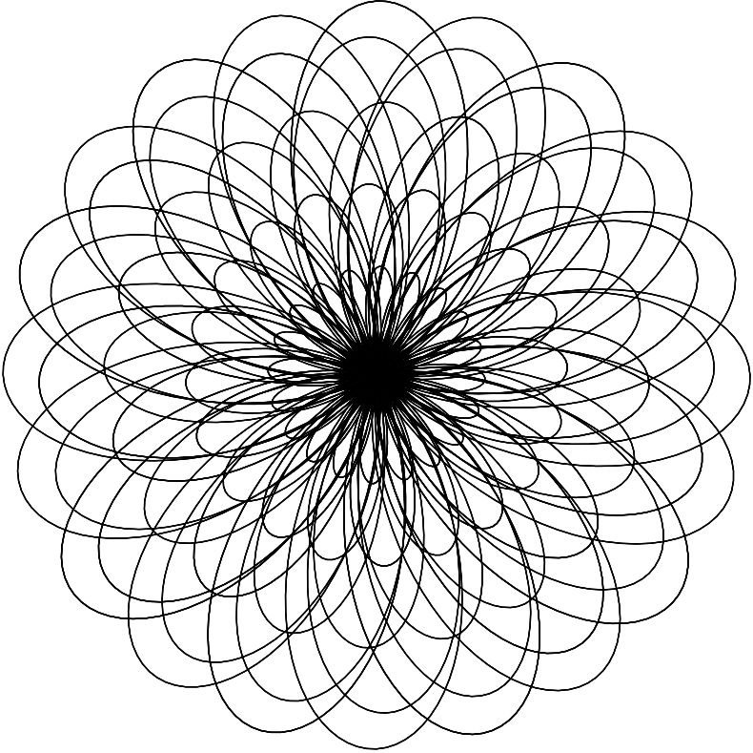
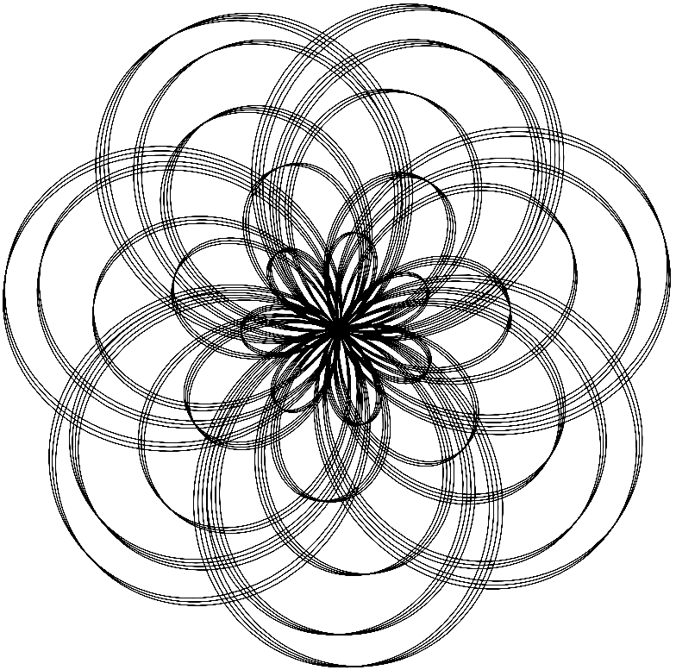
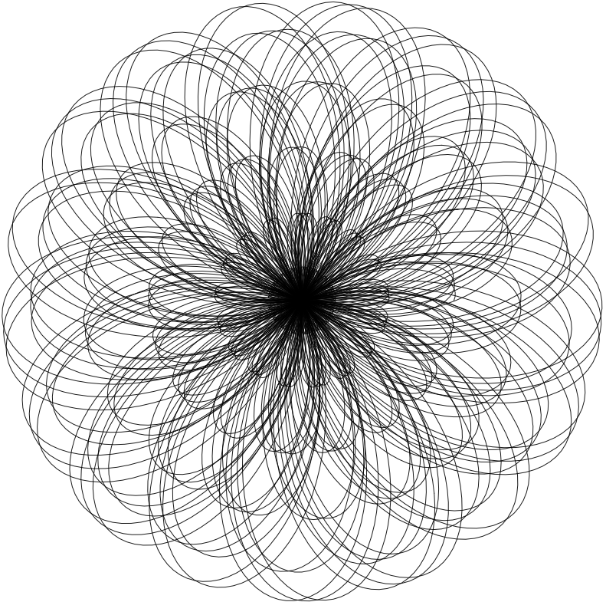
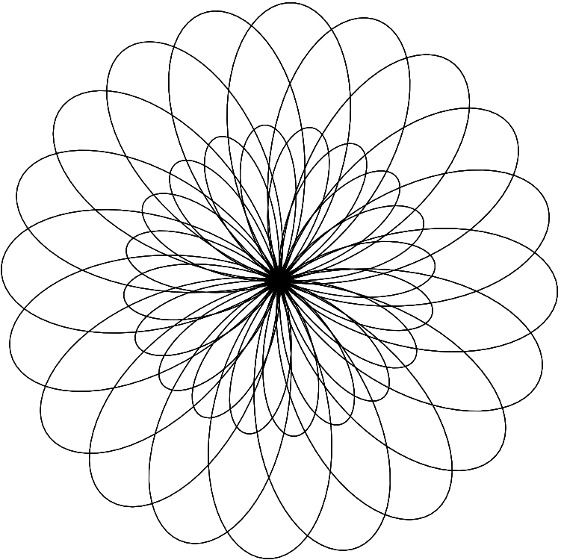
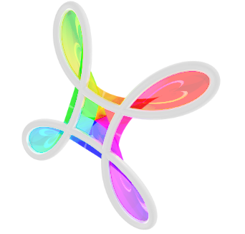
Explore the Beauty of Physics Through Art!
Geometrical Art
February 3, 2024
2:00-4:00 p.m.
University of Nebraska-Lincoln
Streubel Lab

Slide 2
Program Introduction
2
Saturdays 2:00-4:00 P.M.
February 3, 2024 : Geometrical Art
Spirographs
February 10, 2024 : Pendulum Motion
Harmonographs
February 17, 2024 : Nature of Waves
Diffraction
February 24, 2024 : Magnetic Art
Ferrofluids
Explore the Beauty of Physics Through Art!
Geometrical Art

Slide 3
Who we Are
3
Bryce Herrignton
Amir Tarkian
Robert Streubel
Angelea Arnett
Ruthi Sielinski
Explore the Beauty of Physics Through Art!
Geometrical Art

Slide 4
Overview
4
2:00-2:30 Introduction to Spirographs
Mathematical Foundation
Rundown of Coding
2:30-3:30 Hands on Application and Modeling
Explore on your own!
3:30-4:00 Tour of the Physics Building
Guided tour given by undergraduate students
Explore the Beauty of Physics Through Art!
Geometrical Art

Slide 5
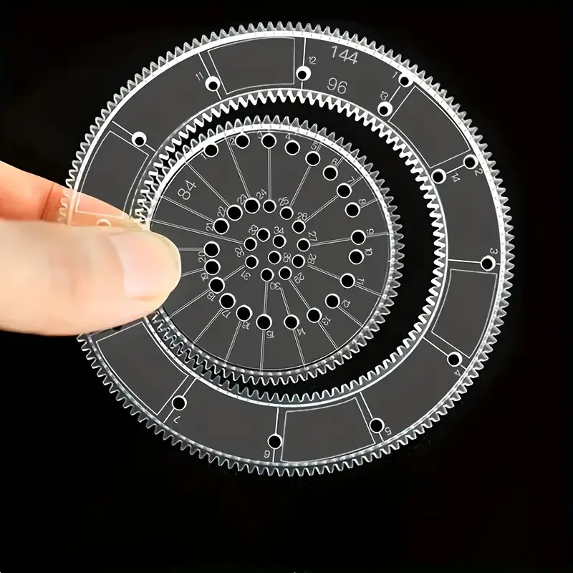
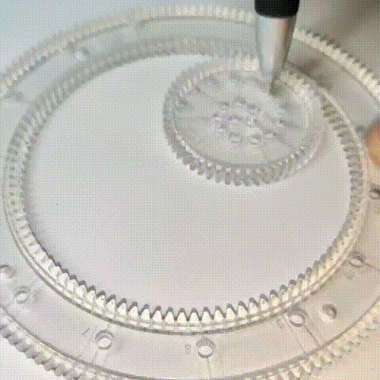
Spirographs
5
Designs are made either as a Hypotrochoid or Epitrochoid
Explore the Beauty of Physics Through Art!
Geometrical Art

Slide 6
Spirograph Geometry
6
Hypotrochoid
Epitrochoid
Explore the Beauty of Physics Through Art!
Geometrical Art

Slide 7
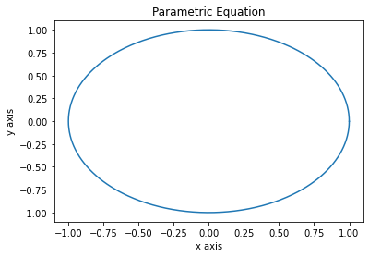
Geometry
7
Described by a set of parametric equations
Will describe a curve or surface given a new independent parameter, t.
$$x=\cos\left(t\right)$$
$$y=\sin\left(t\right)$$
$$\left(x,y\right)=(\cos{t}, sint)$$
time t | x(t) | y(t)
0 s | 1 | 0
π/2 s | 0 | 1
π s | -1 | 0
3π/2 s | 0 | -1
2π s | 1 | 0
Explore the Beauty of Physics Through Art!
Geometrical Art

Slide 8
Geometry
8
Described by a set of parametric equations
Will describe a curve or surface given a new independent parameter, t.
$$x=\cos\left(t\right)$$
$$y=\sin\left(t\right)$$
$$z=t$$
$$\left(x,y,z\right)=(\cos{t}, sint,t)$$
time t | x(t) | y(t) | z(t)
0 s | 1 | 0 | 0
π/2 s | 0 | 1 | π/2
π s | -1 | 0 | π
3π/2 s | 0 | -1 | 3π/2
2π s | 1 | 0 | 2π
Explore the Beauty of Physics Through Art!
Geometrical Art

Slide 9
Kinematics of Objects
9
For example, here t can represent time and can be used for kinematics of an object moving through space-time.
time t | x(t) | y(t) | z(t)
0 s | 0 | 0 | 0
1 s | 1 | 1 | 1
2 s | 2 | 2 | 2
3 s | 3 | 3 | 3
Explore the Beauty of Physics Through Art!
Geometrical Art

Slide 10
Projectile Motion
10
Here we see an objects trajectory after being launched.
$$x\left(t\right)=x_{i}+v_{xi}∗t$$
$$y\left(t\right)=y_{i}+v_{yi}∗t$$
$z\left(t\right)=z_{i}+v_{zi}∗t+\frac{1}{2}g∗t^{2}$
Initial Position: $(x_{i}, y_{i}, z_{i})$
Initial Velocity: $(v_{xi}, v_{yi}, v_{zi})$
$g=9.81\frac{m}{s}$
Explore the Beauty of Physics Through Art!
Geometrical Art

Slide 11
Polar Coordinate System
11
Rather than use (x(t), y(t)) to describe our system, we will use (r(t), θ(t)), Polar Coordinates!
To convert between cartesian coordinates and polar coordinates we can use these:
$$y$$
$$x=r∗cos(θ)$$
$$y=r∗\sin\left(θ\right)$$
$$r=\sqrt{x^{2}+y^{2}}$$
$$θ=\tan^{−1}\left(\frac{y}{x}\right)$$
$$r$$
$$θ$$
$$x$$
Explore the Beauty of Physics Through Art!
Geometrical Art

Slide 12
Polar Coordinate System
12
For a particle on a circular path, we have two different sets of coordinates:
Cartesian
Polar
time t | x(t) | y(t)
0 s | 1 | 0
1 s | 0 | 1
2 s | -1 | 0
3 s | 0 | -1
time t | r(t) | θ(t)
0 s | 1 | 0
1 s | 1 | π/2
2 s | 1 | π
3 s | 1 | 3π/2
$$r$$
$$θ$$
Explore the Beauty of Physics Through Art!
Geometrical Art

Slide 13
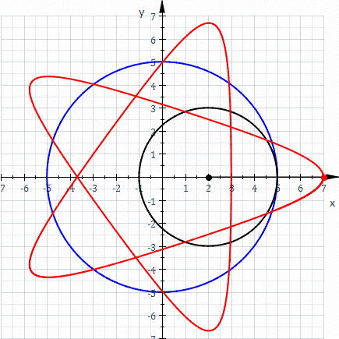
Hypotrochoids
13
Path traced out by
a point attached to a
smaller circle as it
rolls inside a bigger
circle.
Recall: Hypo- means beneath or below. In this case it refers to inside the circle.
2008-01-03 02:51 Sam Derbyshire Animation of an Hypotrochoid.
Explore the Beauty of Physics Through Art!
Geometrical Art

Slide 14
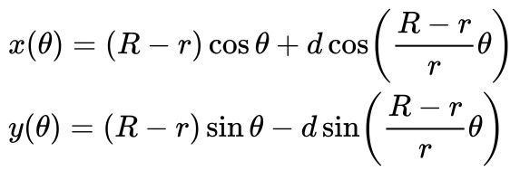
Hypotrochoids
14
r ~ inside circle radius
R ~ outer circle radius
d ~ distance to point from circle center
θ ~ angle between horizontal and center of rolling circle
θ
d
r
R
Explore the Beauty of Physics Through Art!
Geometrical Art

Slide 15
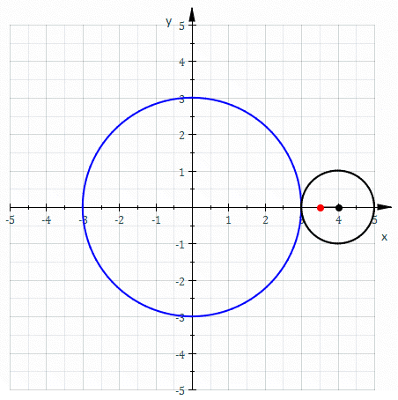
Epitrochoids
15
Path traced out by
a point attached to a
smaller circle as it
rolls outside a bigger
circle.
Recall: Epi- means over. In this case it means outside the circle.
2008-01-03 02:51 Sam Derbyshire Animation of an Epitrochoid.
Explore the Beauty of Physics Through Art!
Geometrical Art

Slide 16
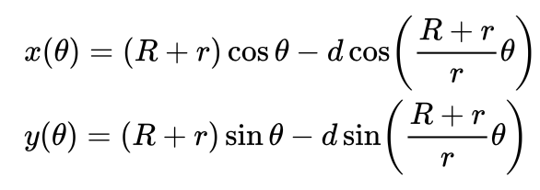
Epitrochoids
16
r ~ inside circle radius
R ~ outer circle radius
d ~ distance to point from circle center
θ ~ angle between horizontal and center of rolling circle
θ
d
r
R
Explore the Beauty of Physics Through Art!
Geometrical Art

Slide 17
Coding of Spirographs
17
We will be using Python coding to explore the spirographs.
https://colab.google is the site we will use to run the coding files
Explore the Beauty of Physics Through Art!
Geometrical Art

Slide 18
Coding of Spirographs
18
The files to explore for the spirographs:
Hypotrochoid.ipynb
Epitrochoid.ipynb
If you are interested, you can also explore the parametric equations with these:
ParametricEquationPlotter.ipynb
3D-Projectile.ipynb
Explore the Beauty of Physics Through Art!
Geometrical Art

Slide 19
Coding of Spirographs
19
Hypotrochoid.ipynb
Explore the Beauty of Physics Through Art!
Geometrical Art

Slide 20
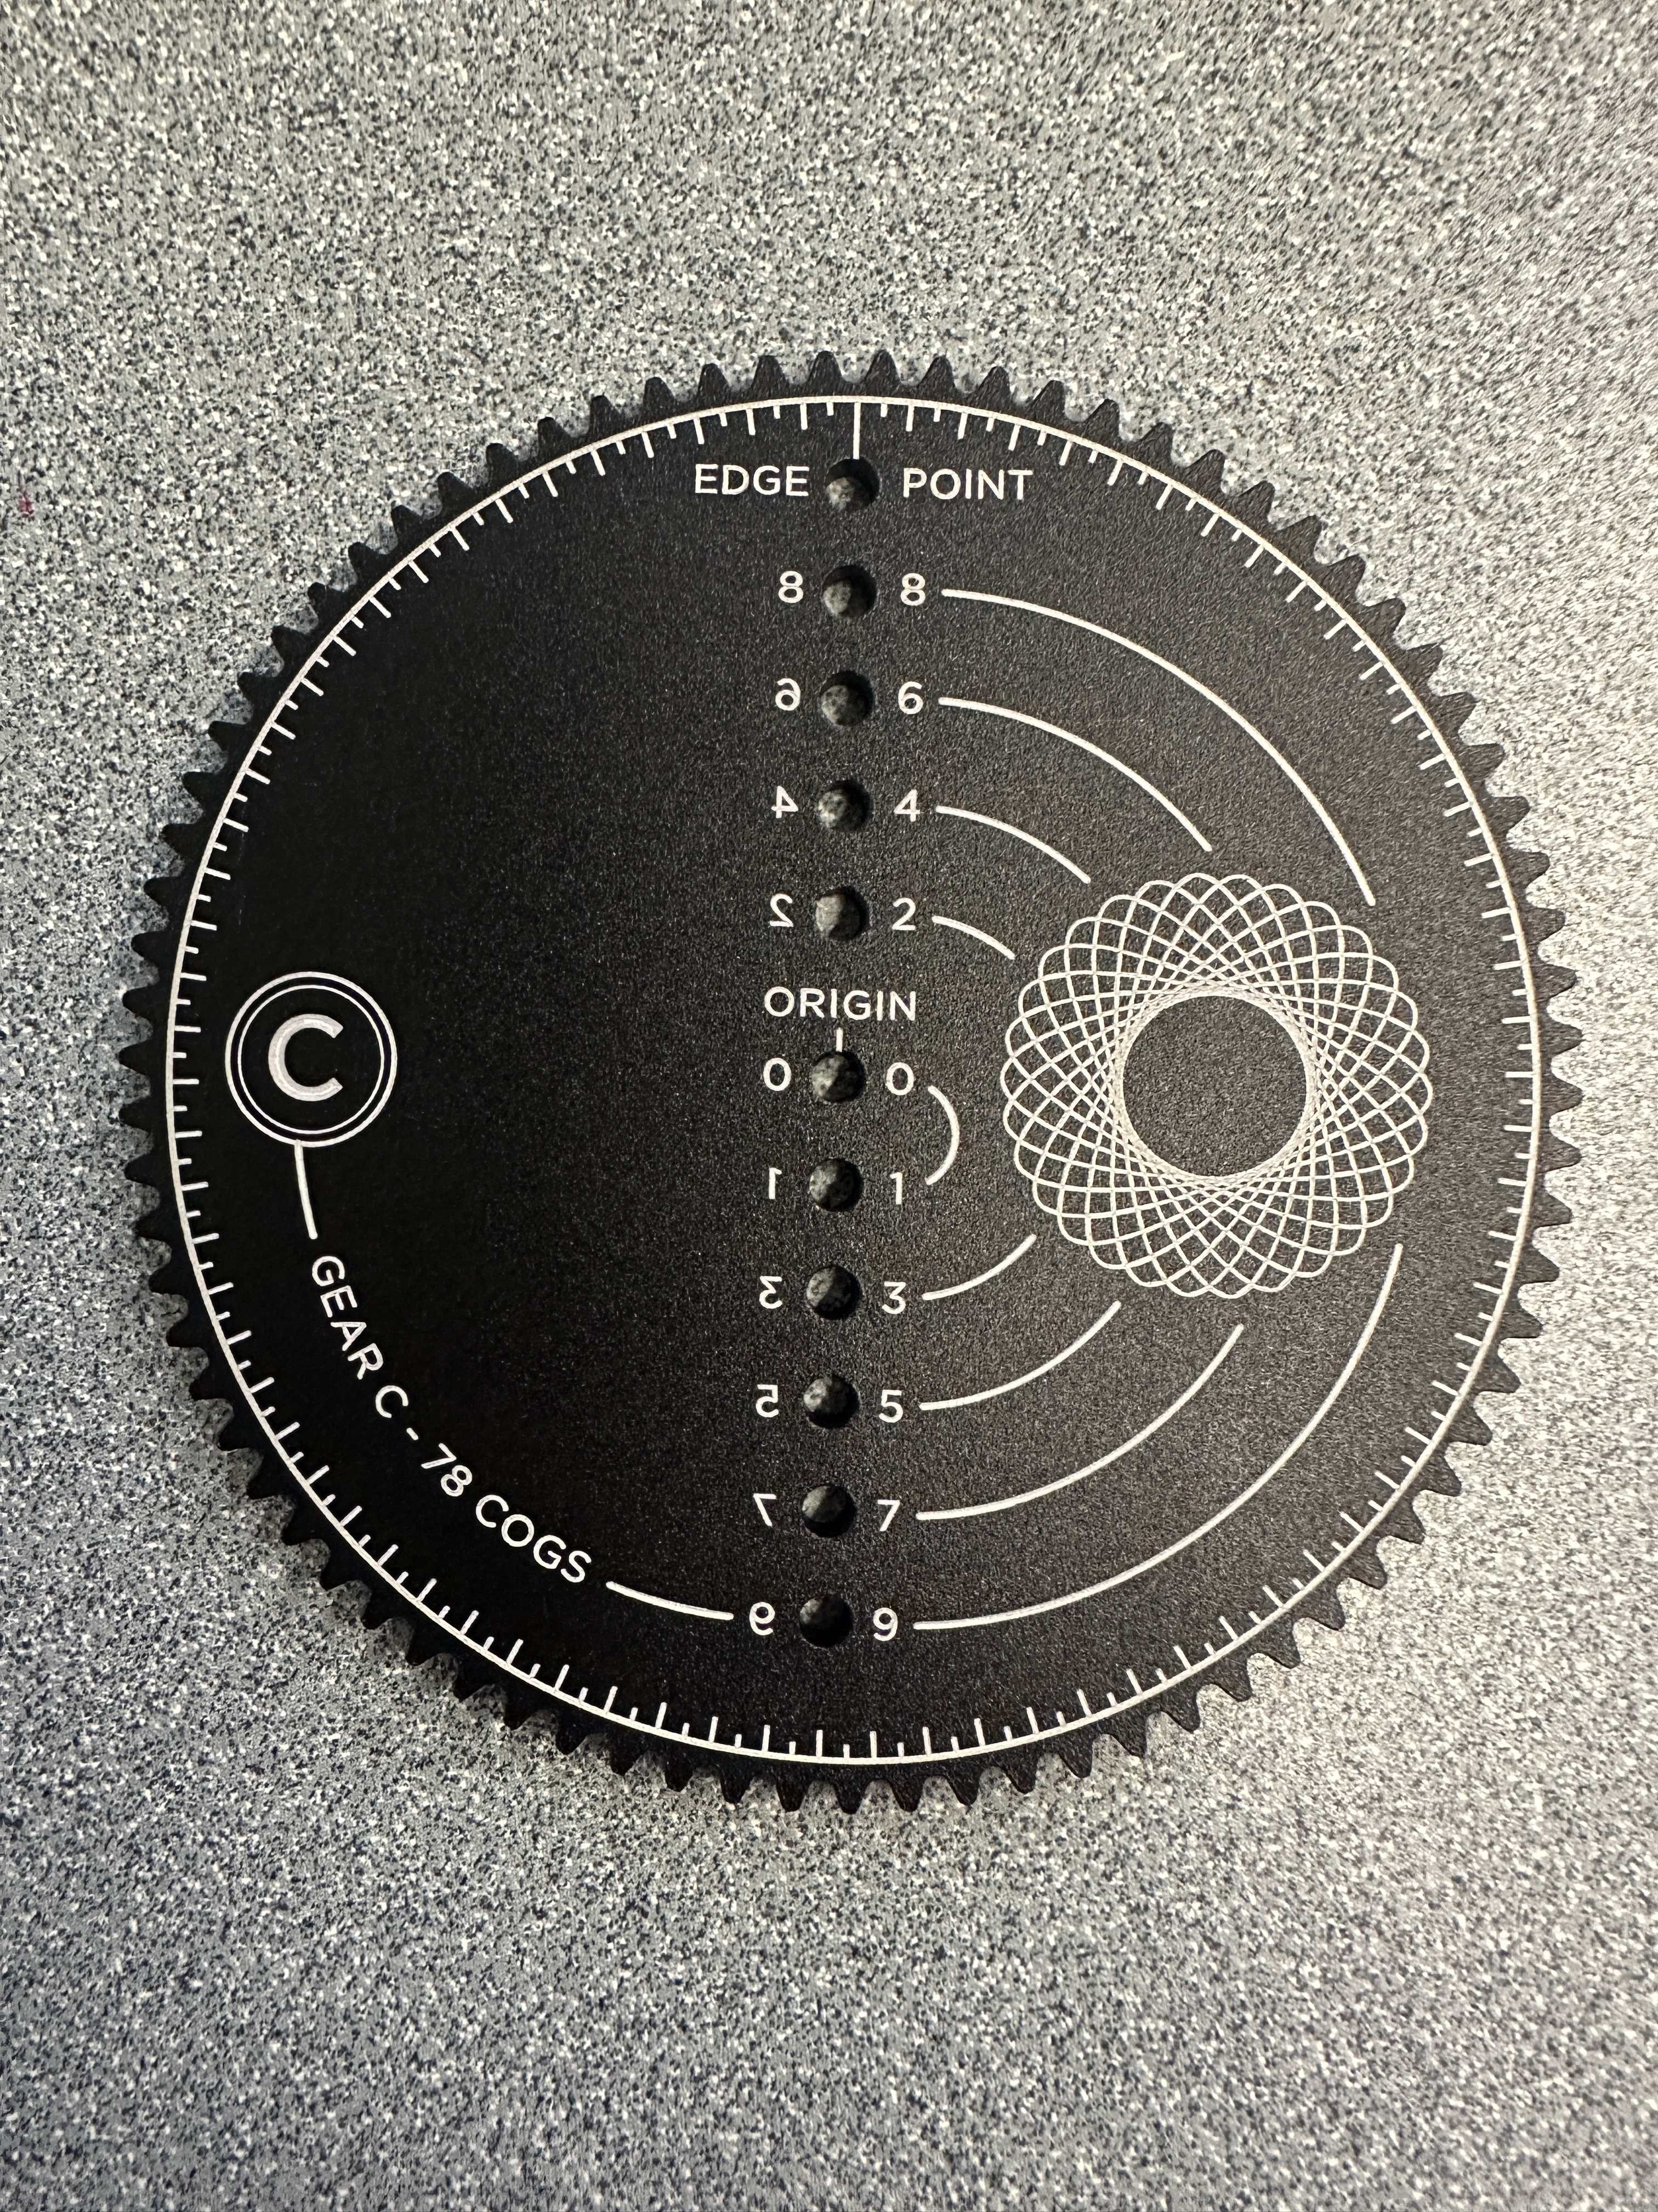
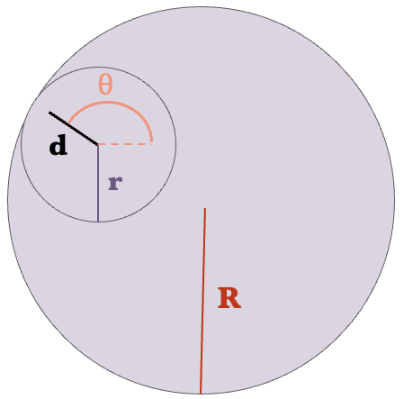
Coding of Spirographs
20
Hypotrochoid.ipynb
Since radius and circumference are directly related: $C=2πr$
we can use the number of cogs given on each piece of the spirographs.
Explore the Beauty of Physics Through Art!
Geometrical Art

Slide 21
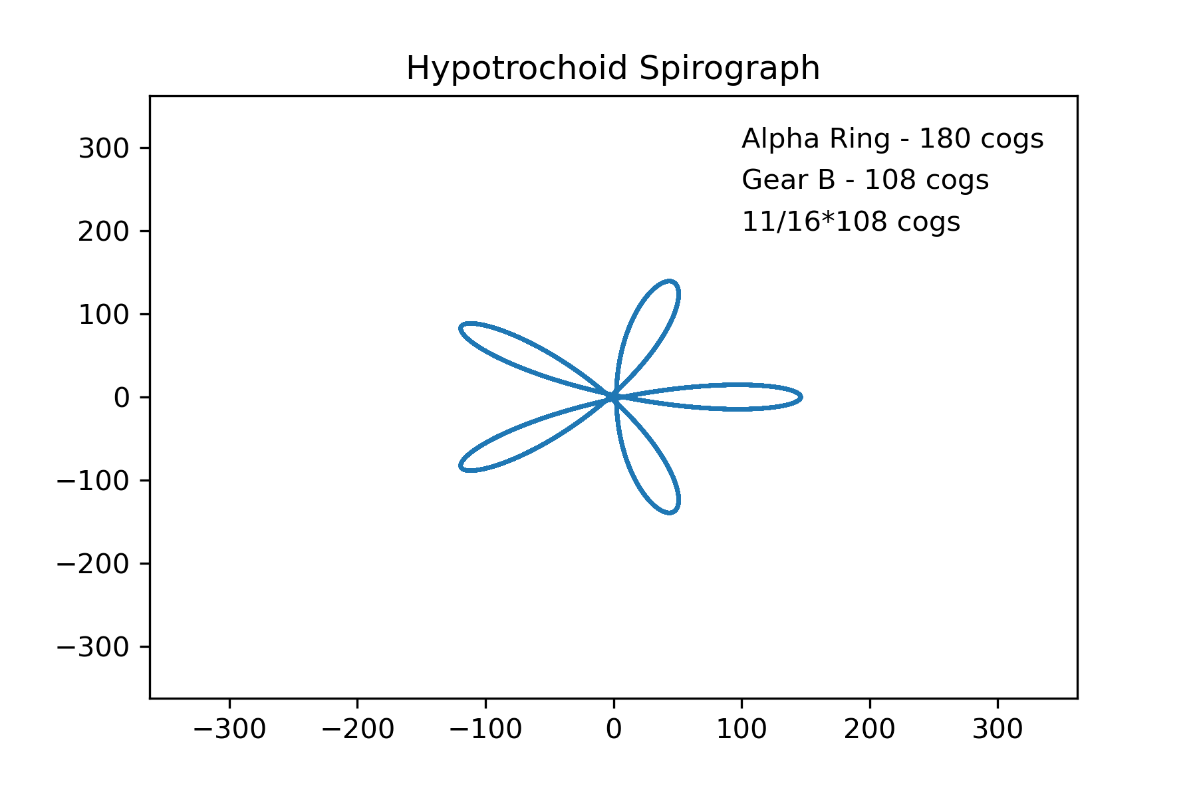
Coding of Spirographs
21
Hypotrochoid.ipynb
Example 1:
Explore the Beauty of Physics Through Art!
Geometrical Art

Slide 22
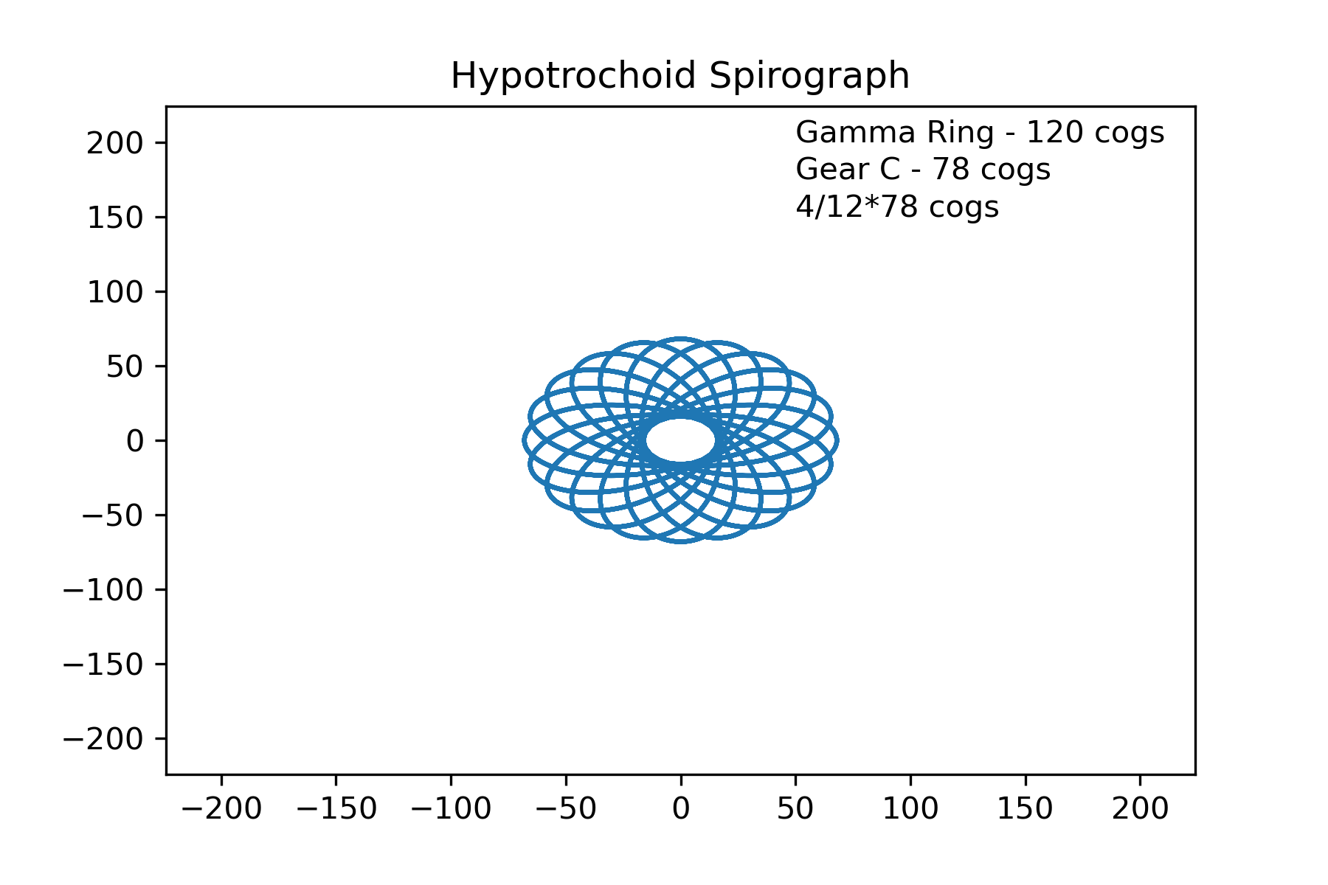
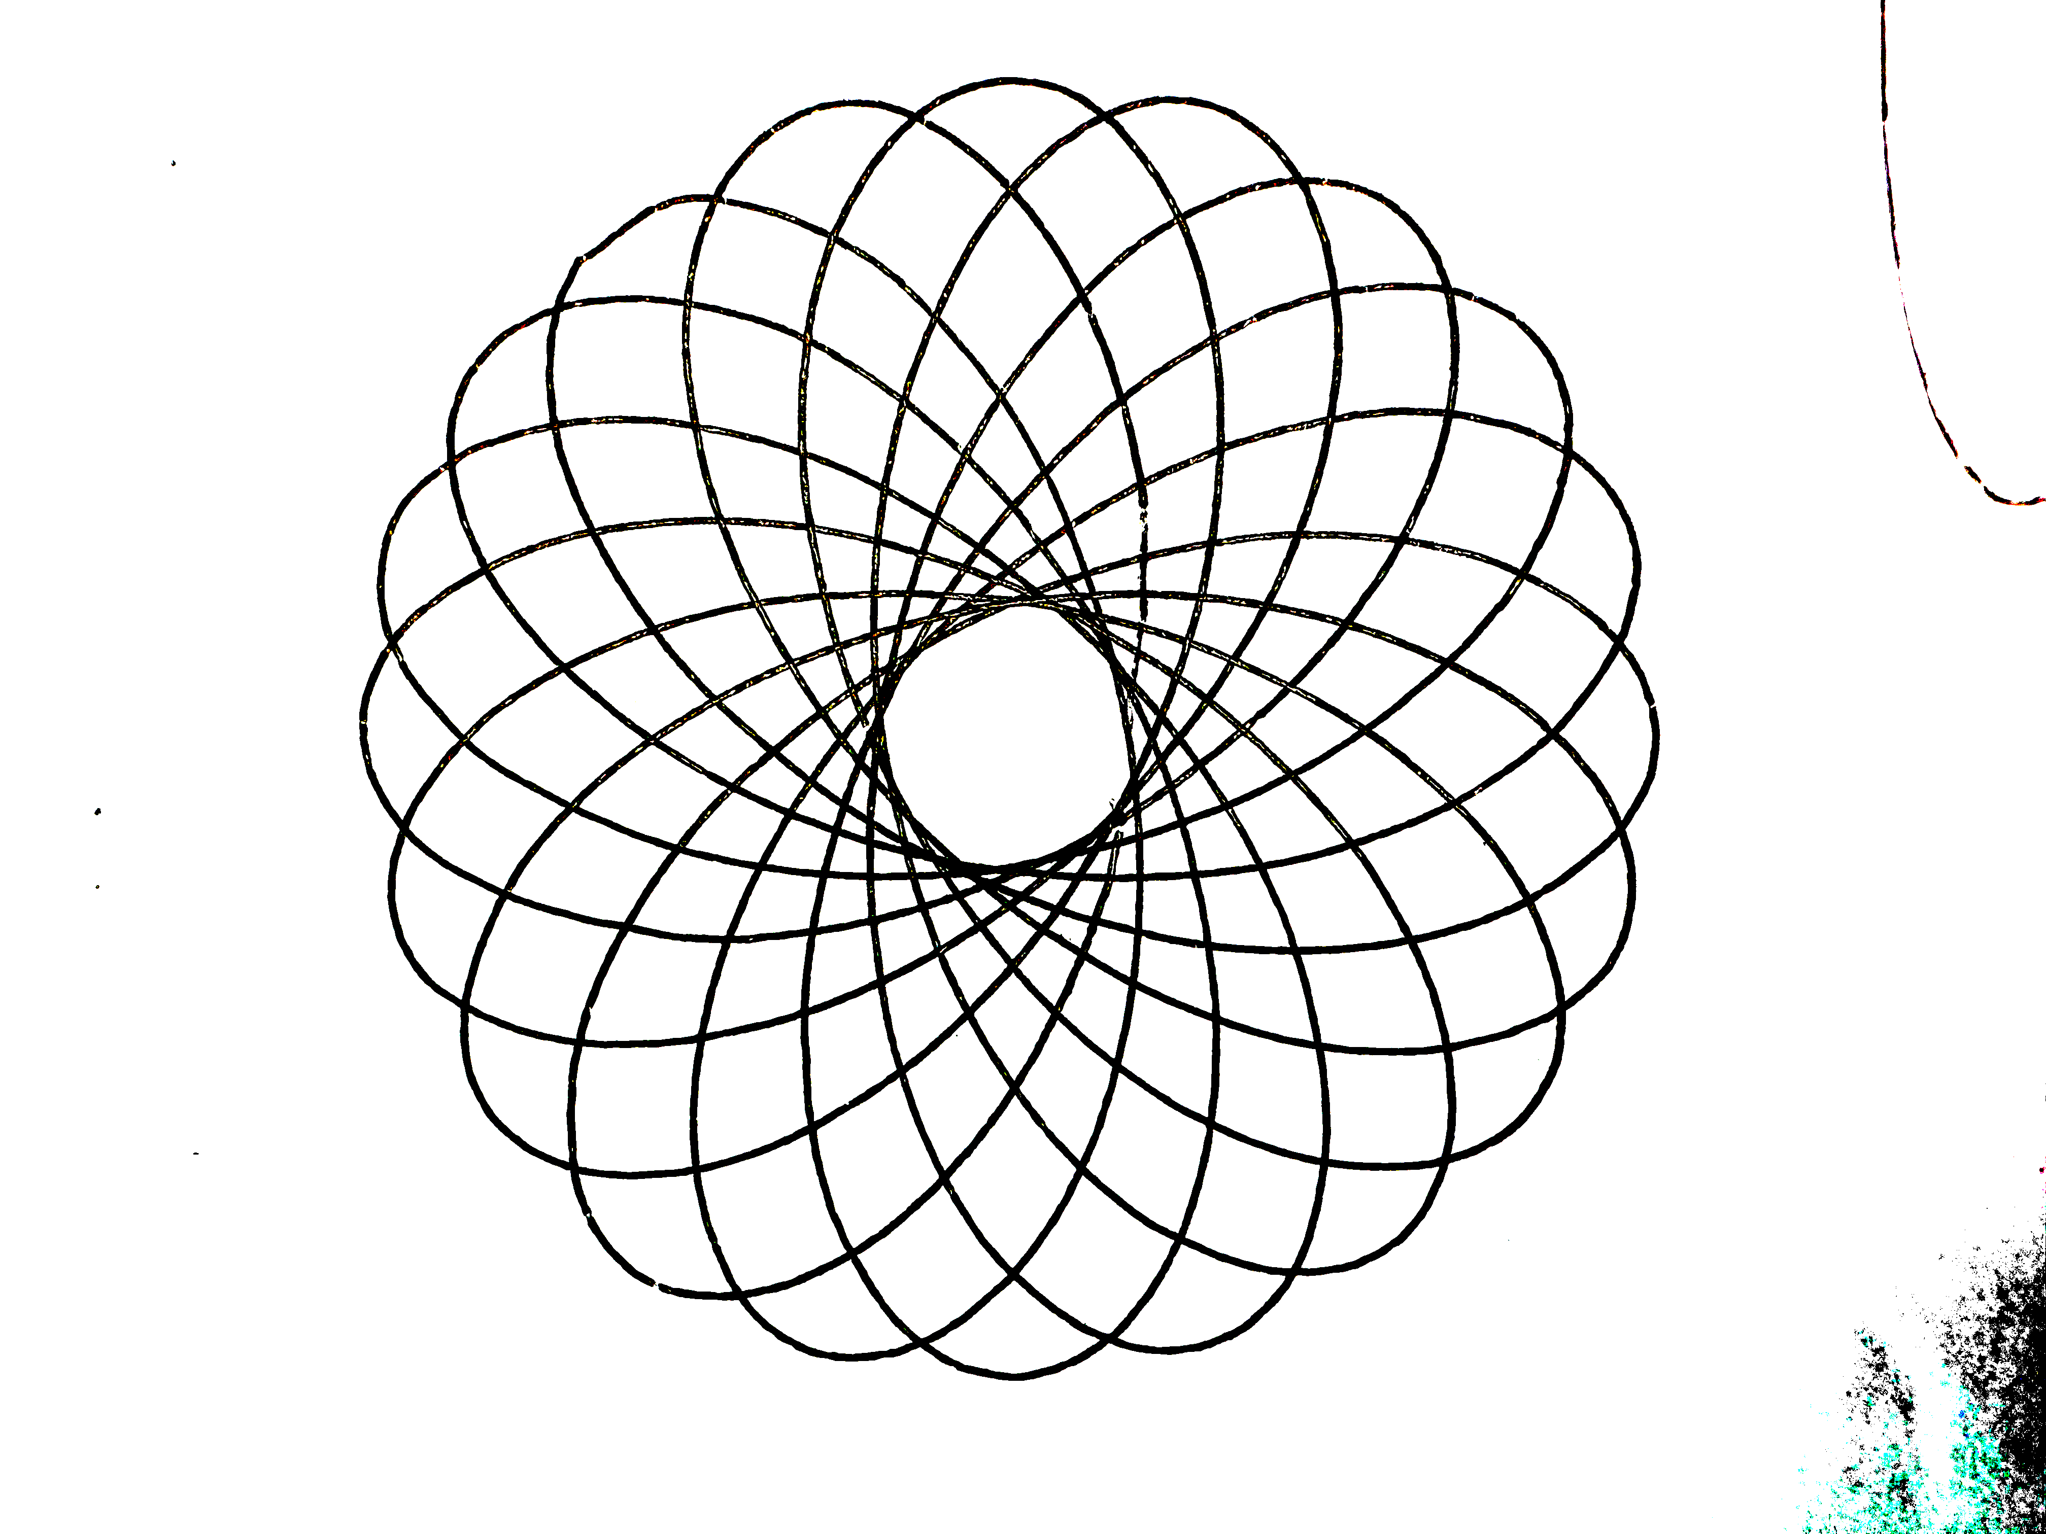
Coding of Spirographs
22
Hypotrochoid.ipynb
Example 2:
Explore the Beauty of Physics Through Art!
Geometrical Art

Slide 23
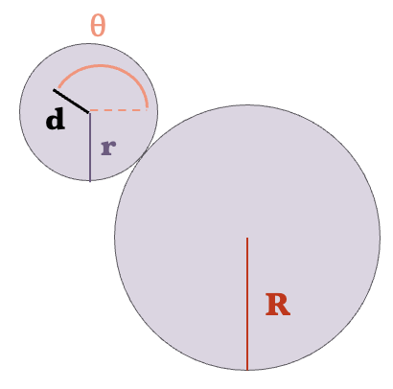
Hands on Application
23
Try and see if you can get your spirograph artwork to match the coding output.
Have fun and if you have any questions we are here to help!
Hypotrochoid
Epitrochoid
Explore the Beauty of Physics Through Art!
Geometrical Art

Slide 24
Summary
24
Learned mathematical principals to describe a spirographs motion.
Introduction to coding in Python in order to model the mathematics behind a spirograph.
Hands on application and created your own artwork!
Explore the Beauty of Physics Through Art!
Geometrical Art

Slide 25
Acknowledgments
25
This series is offered as part of the START SMART program:
We gratefully accept funding from The National Science Foundation under grant no. 2203933
We also are supported by the UNL CAS Research Impact and Engagement Grant: START SMART
Explore the Beauty of Physics Through Art!
Geometrical Art

