Slide 1

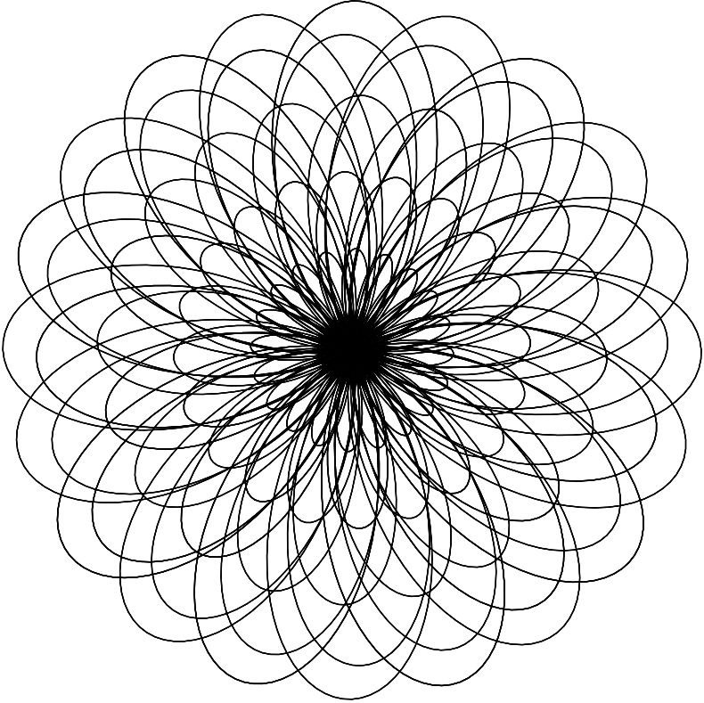
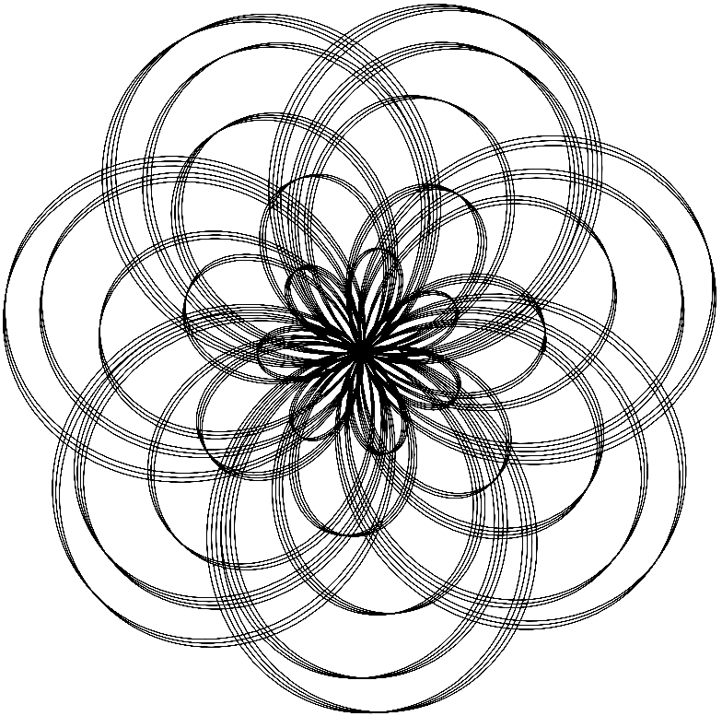
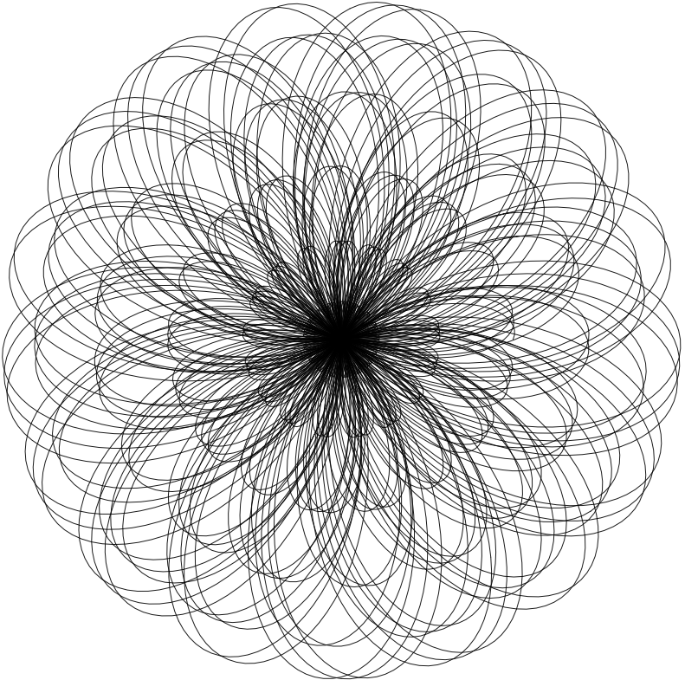
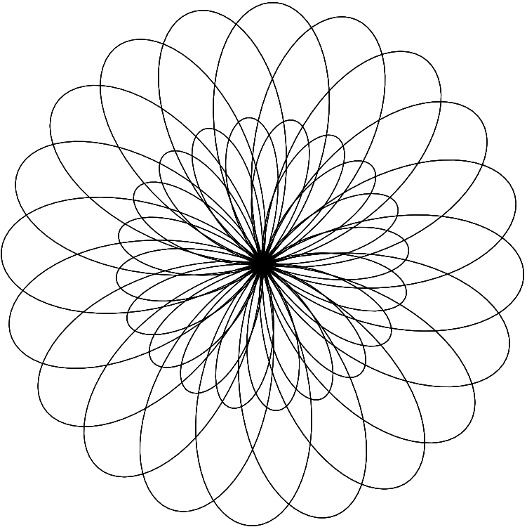
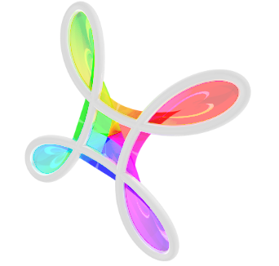

Explore the Beauty of Physics Through Art!
Nature of Waves
February 17, 2024
2:00-4:00 p.m.
University of Nebraska-Lincoln
Streubel Lab

Slide 2
Program Introduction
2
Saturdays 2:00-4:00 P.M.
February 3, 2024 : Geometrical Art
  Spirographs
February 10, 2024 : Pendulum Motion
  Harmonographs
February 17, 2024 : Nature of Waves
  Diffraction
February 24, 2024 : Magnetic Art
  Ferrofluids
Explore the Beauty of Physics Through Art!
Geometrical Art

Slide 3




Who we Are
3
Bryce Herrignton
Angelea Arnett
Ruthi Sielinski
Robert Streubel
Explore the Beauty of Physics Through Art!
Geometrical Art

Slide 4
Overview
4
2:00-2:30 Introduction to Waves
            What are waves? and different types
            Acoustic waves and real-world examples
2:30-3:00 Acoustic wave demonstrations
            Water ripples and Chladni plates
3:00-3:30 Make your own Chladni plate patterns
3:30-4:00 Q&A: What to do with a physics degree?
            Ask the undergraduates any questions you might have!
Explore the Beauty of Physics Through Art!
Geometrical Art

Slide 5
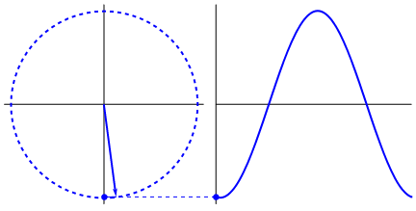
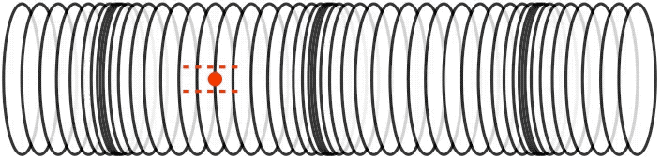
What is a “wave” anyway?
5
A wave is a propagating disturbance that carries energy (in particles, light, etc.)
Waves do not need to move matter in one direction
Waves can take many forms, such as pulses or sinusoids
https://stackoverflow.com/questions/40291618/animating-sine-waves-in-processing
Explore the Beauty of Physics Through Art!
Nature of Waves

Slide 6
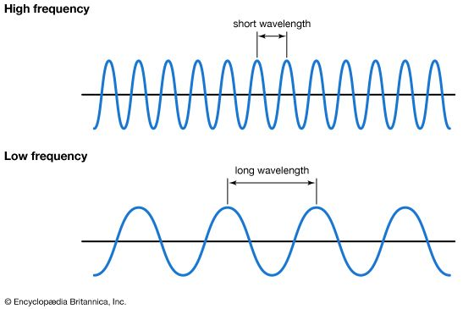
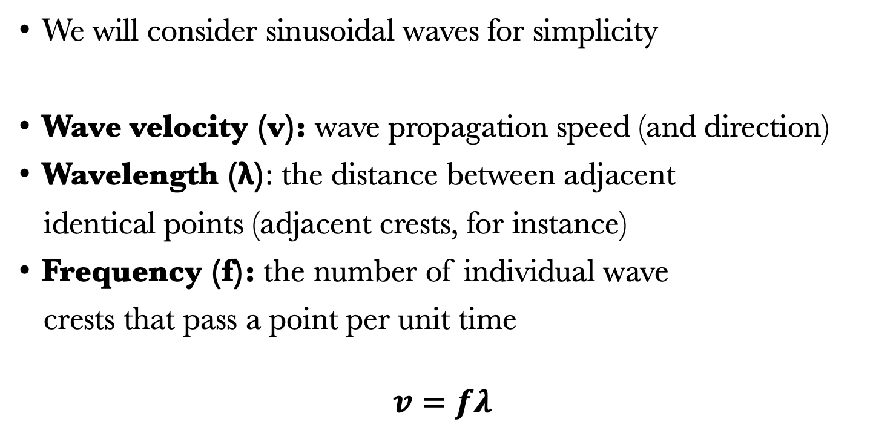
Important characteristics of waves
6
We will consider sinusoidal waves for simplicity
Wave velocity (v): wave propagation speed (and direction)
Wavelength (λ): the distance between adjacent
identical points (adjacent crests, for instance)
Frequency (f): the number of individual wave
crests that pass a point per unit time
$$v=fλ$$
Explore the Beauty of Physics Through Art!
Nature of Waves

Slide 7
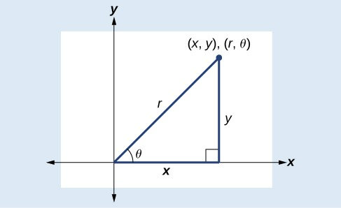
Sinusoids as projections of a circle
7
Sine and cosine waves at a certain amplitude are the horizontal and vertical parts of the point on the circle.
Considering uniform motion around a circle, the x-component is a cosine wave since for radius r and angle θ:
$$y=r sin⁡(θ)$$
Explore the Beauty of Physics Through Art!
Nature of Waves

Slide 8
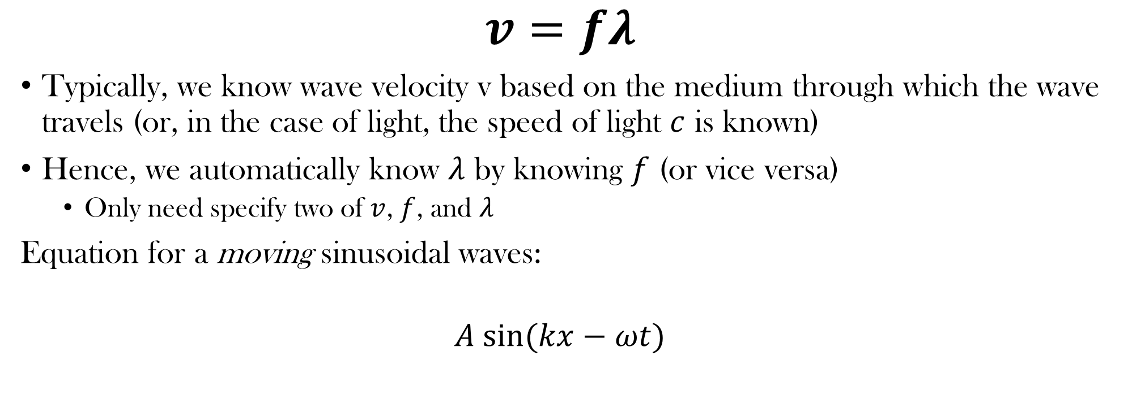
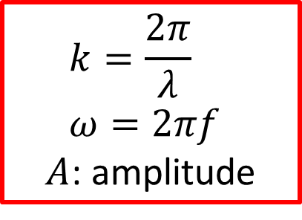
Wave characteristics (cont.)
8
$$v=fλ$$
Typically, we know wave velocity v based on the medium through which the wave travels (or, in the case of light, the speed of light $c$ is known)
Hence, we automatically know $λ$ by knowing $f$ (or vice versa)
  Only need specify two of $v$, $f$, and $λ$
Equation for a moving sinusoidal waves:
$$A sin⁡(kx−ωt)$$
  $$k=\frac{2π}{λ}$$
  $$ω=2πf$$
$A$: amplitude
Explore the Beauty of Physics Through Art!
Nature of Waves

Slide 9
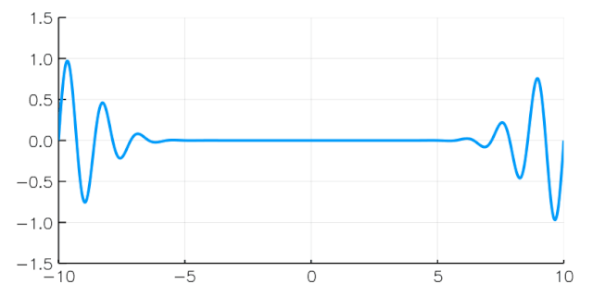
Creating different types of waves
9
By adding various sine waves of different frequencies and amplitudes with, we can construct interesting wave patterns
For instance, we can construct “packets” or pulses
Important for communication with devices
Models wave-particle duality
  A particle is like a localized wave
  Get one with envelope
https://commons.wikimedia.org/wiki/File:Wave_packet_propagation_%28phase_faster_than_group,_dispersive%29.gif
Explore the Beauty of Physics Through Art!
Nature of Waves

Slide 10
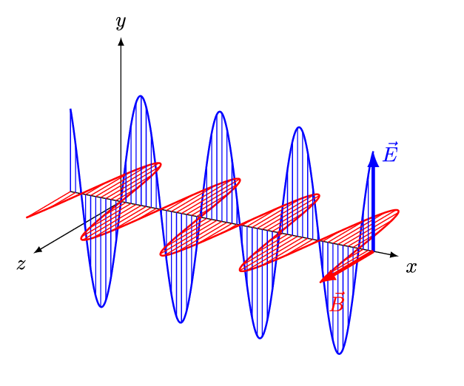
Types of waves
10
Matter (mechanical) waves: waves propagate through a medium (air, water, solids, etc.) which carries the energies
Electromagnetic waves (light): consists of perpendicular oscillating electric and magnetic fields. Unlike mechanical waves, EM waves are self-propagating (do not require a medium).
  Oscillating (moving) electric and magnetic fields induce one another
https://commons.wikimedia.org/wiki/File:EM-Wave.gif
Explore the Beauty of Physics Through Art!
Nature of Waves

Slide 11
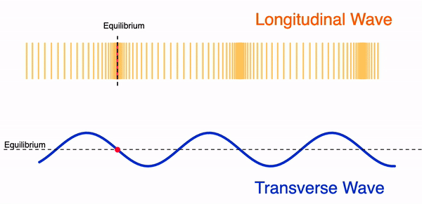
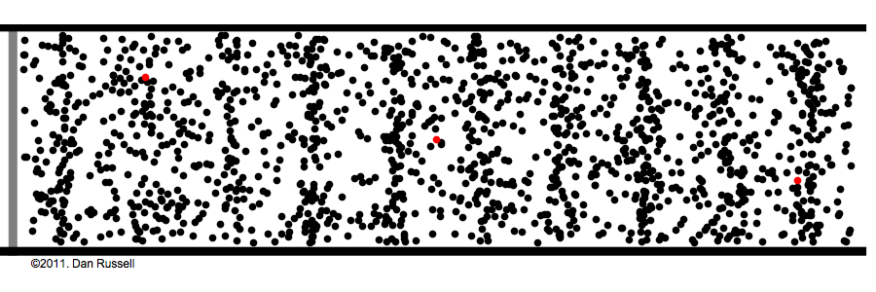
Mechanical waves
11
Transverse wave: perpendicular oscillation
Longitudinal wave: parallel oscillation
  With respect to propagation direction
Acoustic wave: longitudinal wave generated from vibration of particles
  Audible sound waves are acoustic
Explore the Beauty of Physics Through Art!
Nature of Waves

Slide 12
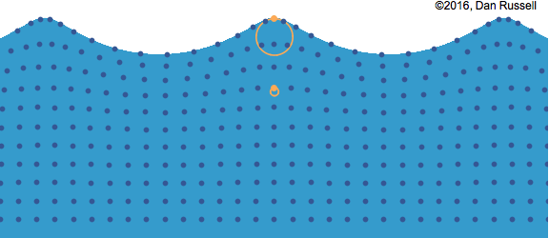
Water waves
12
Daniel A. Russell, Graduate Program in Acoustics, The Pennsylvania State University, “Acoustics and Vibration Animations“
Explore the Beauty of Physics Through Art!
Nature of Waves

Slide 13
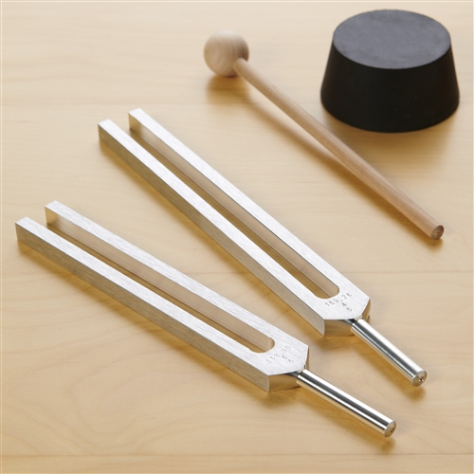

Resonance frequencies
13
Materials can have certain “natural oscillations”
Can more easily vibrate/store energy at those frequencies – not “forced”
https://altairuniversity.com/41081-digital-debunking-can-you-actually-shatter-glass-with-your-voice/
Explore the Beauty of Physics Through Art!
Nature of Waves

Slide 14
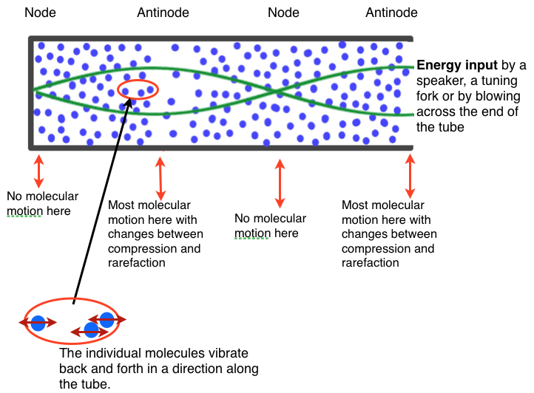
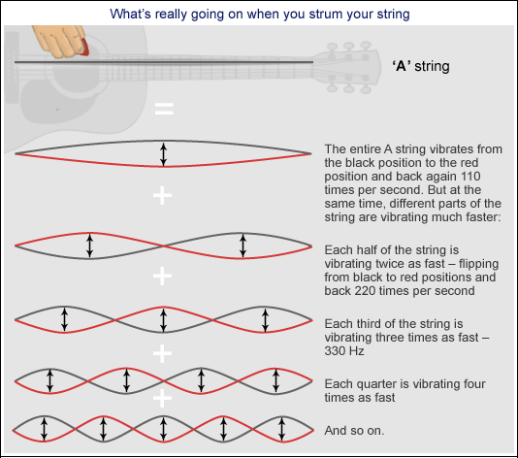
Musical instruments and harmonic frequencies
14
https://www.fizzics.org/standing-waves-in-a-tube/
The length of the tubes (of woodwind instruments, for example) restricts what notes you can play to ones with frequencies aligning with the tube
https://www.abc.net.au/science/articles/2011/04/27/3201318.htm
Explore the Beauty of Physics Through Art!
Nature of Waves

Slide 15
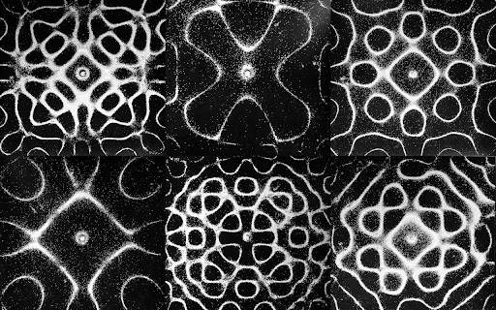
Chladni plate
15
Mass distribution, geometry, and thickness of plate cause patterns
Explore the Beauty of Physics Through Art!
Nature of Waves

Slide 16
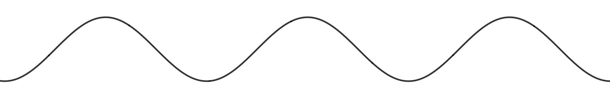

Interference
16
Constructive Interference:
Destructive Interference:
+
+
Amplitudes are additive
Amplitudes cancel out
Explore the Beauty of Physics Through Art!
Nature of Waves

Slide 17
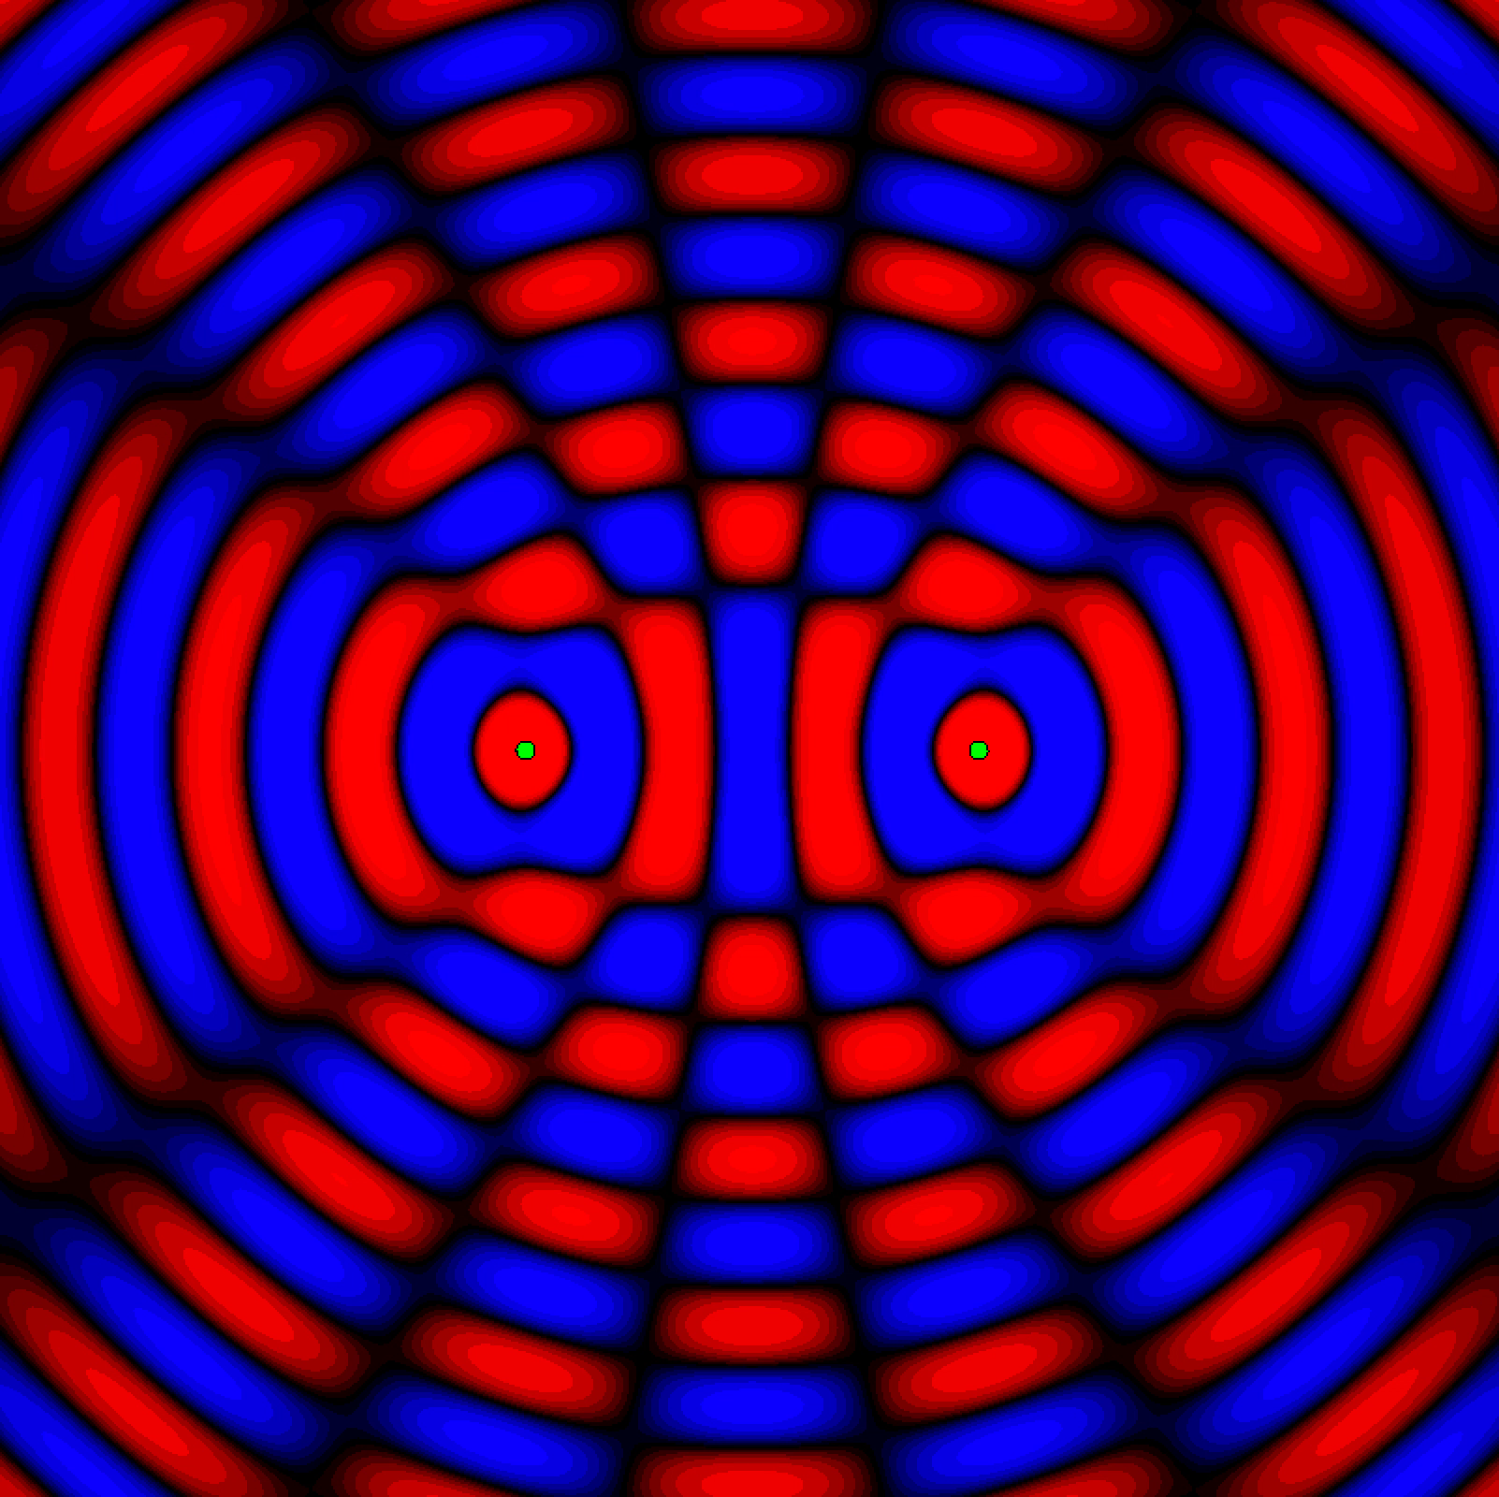
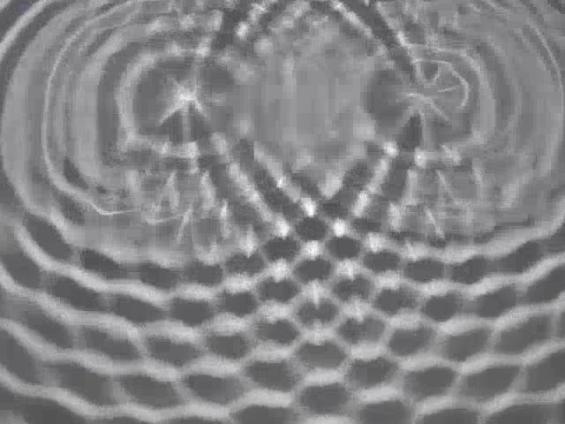
Ripple chamber
17
We can see constructive and destructive interference in action using water ripples
For interference, we need at least two sources (or reflection of one wave onto itself)
Explore the Beauty of Physics Through Art!
Nature of Waves

Slide 18
Wave Diffraction
18
A wave will bend as it goes around an object or through a slit. This is known as diffraction
Huygens’ principle: scattering generates spherical wave
Explore the Beauty of Physics Through Art!
Nature of Waves

Slide 19
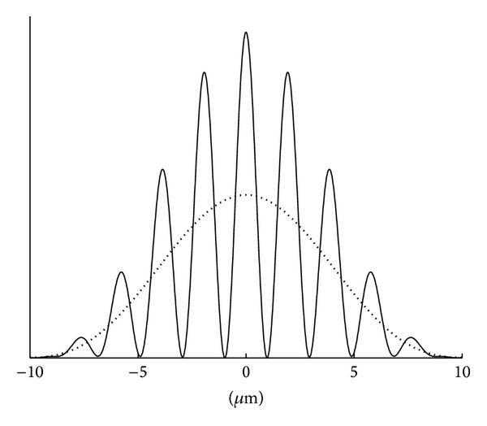


Double-Slit Wave Diffraction
19
Send waves through two slits to generate an interference patterns (constructive and destructive points)
Generates a distribution pattern on a screen/detector
Constructive interference corresponds to regions of higher intensity
Incident Wave
Detector
$$(x)$$
$$I(x)$$
Double Slit
Diffraction Pattern
Explore the Beauty of Physics Through Art!
Nature of Waves

Slide 20
Wave-particle duality - Quantum Mechanics
20
All particles are also waves, but this is more visible for smaller, less massive particle
  Electrons, protons, etc.
Can be experimentally proven using previous knowledge on wave diffraction
Higher concentration of particles represents higher probability
Electron Emitter
Wave-Particle Duality
Detector
Probability
Intensity
Explore the Beauty of Physics Through Art!
Nature of Waves

Slide 21
What to do with a Physics Degree?
21
Now it is time for you to ask us questions!
Explore the Beauty of Physics Through Art!
Pendulum Motion

Slide 22
Summary
22
Learned about different types of waves.
Learned about constructive and destructive interference.
Learned about diffraction and demonstrating how particles are waves.
Hands on application and created your own artwork!
Explore the Beauty of Physics Through Art!
Geometrical Art

Slide 23

Acknowledgments
23
This series is offered as part of the START SMART program:
  We gratefully accept funding from The National Science Foundation under grant no. 2203933
  We also are supported by the UNL CAS Research Impact and Engagement Grant: START SMART
Explore the Beauty of Physics Through Art!
Pendulum Motion

