Slide 1

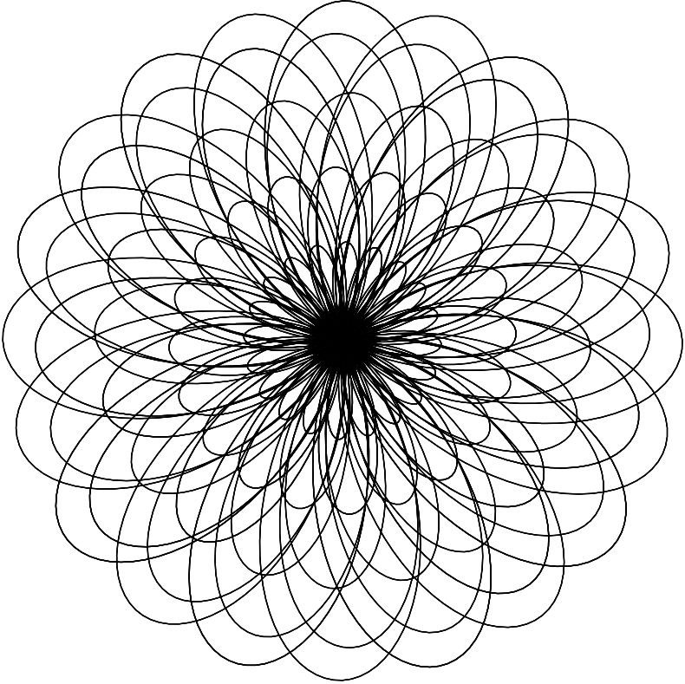
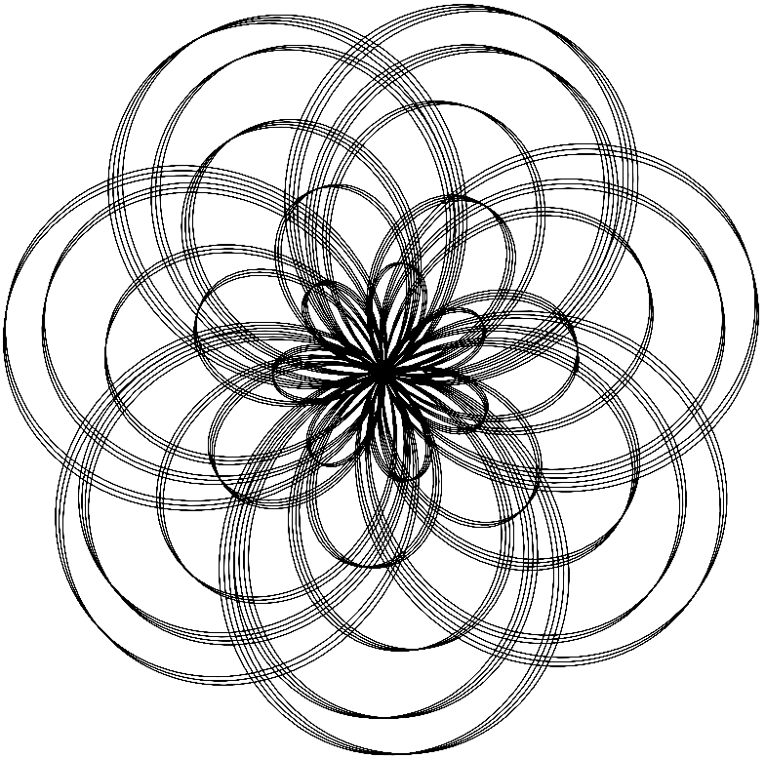
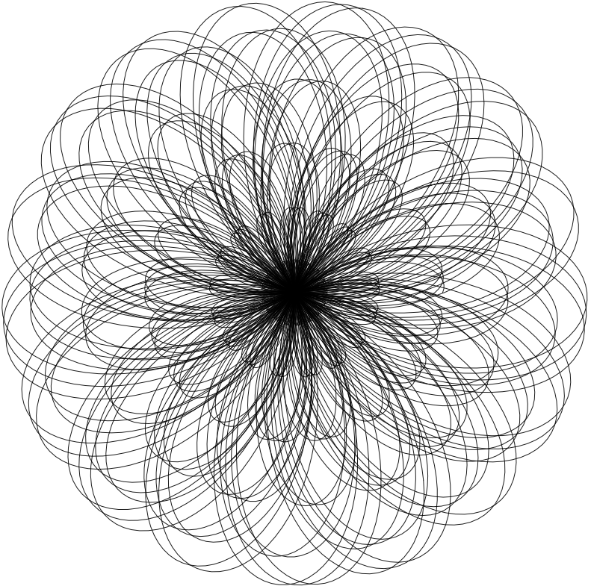
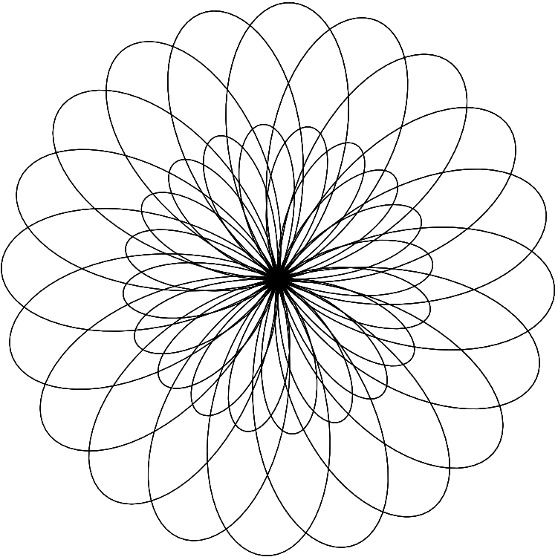
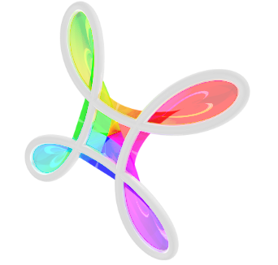

Explore the Beauty of Physics Through Art!
Geometrical Art
February 1, 2025
2:00-4:00 p.m.
University of Nebraska-Lincoln
Streubel Lab

Slide 2
Program Introduction
2
Saturdays 2:00-4:00 P.M.
February 1, 2025 : Geometrical Art
  Spirographs
February 8, 2025 : Nature of Waves
  Diffraction
February 15, 2025 : Pendulum Motion
  Harmonographs
February 22, 2025 : Magnetic Art
  Ferrofluids
Explore the Beauty of Physics Through Art!
Geometrical Art

Slide 3








Who we Are
3
Jing
Guo
Sajid
Akash
Robert Streubel
Angelea Arnett
Ruthi Sielinski
Explore the Beauty of Physics Through Art!
Geometrical Art

Slide 4
Overview
4
2:00-2:30 Introduction to Spirographs
            Mathematical Foundation
            Rundown of Coding
2:30-3:30 Hands on Application and Modeling
            Explore on your own!
3:30-4:00 Tour of the Physics Building
            Guided tour given by undergraduate students
Explore the Beauty of Physics Through Art!
Geometrical Art

Slide 5
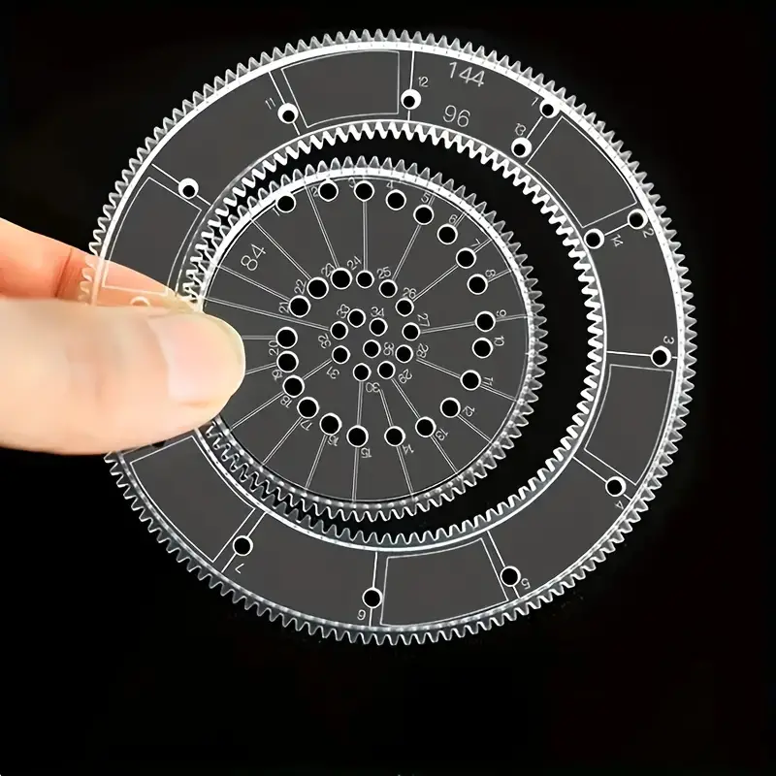
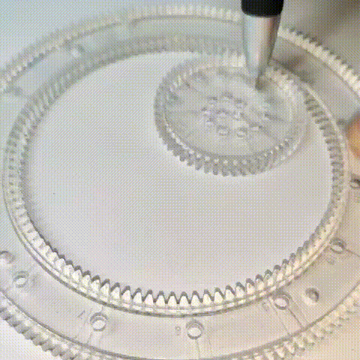
Spirographs
5
Designs are made either as a Hypotrochoid or Epitrochoid
Explore the Beauty of Physics Through Art!
Geometrical Art

Slide 6
Spirograph Geometry
6
Hypotrochoid
Epitrochoid
Explore the Beauty of Physics Through Art!
Geometrical Art

Slide 7
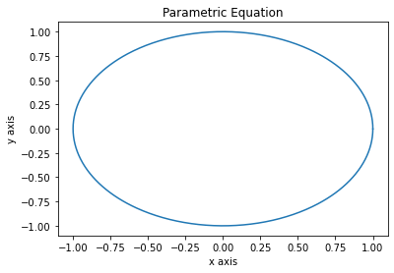

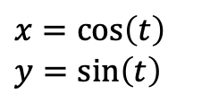
Geometry
7
Described by a set of parametric equations
  Will describe a curve or surface given a new independent parameter, t.
$$x=\cos\left(t\right)$$
$$y=\sin\left(t\right)$$
$$\left(x,y\right)=(\cos{t}, sint)$$
time t | x(t) | y(t)
0 s | 1 | 0
π/2 s | 0 | 1
π s | -1 | 0
3π/2 s | 0 | -1
2π s | 1 | 0
Explore the Beauty of Physics Through Art!
Geometrical Art

Slide 8
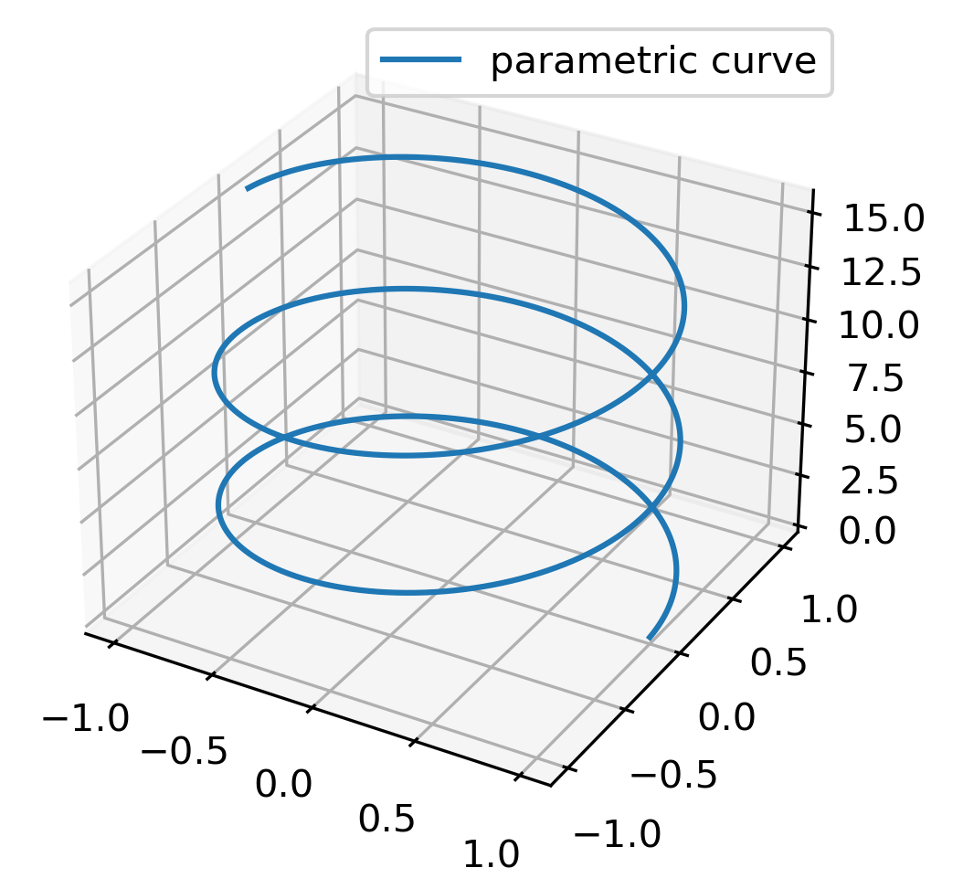


Geometry
8
Described by a set of parametric equations
  Will describe a curve or surface given a new independent parameter, t.
$$x=\cos\left(t\right)$$
$$y=\sin\left(t\right)$$
$$z=t$$
$$\left(x,y,z\right)=(\cos{t}, sint,t)$$
time t | x(t) | y(t) | z(t)
0 s | 1 | 0 | 0
π/2 s | 0 | 1 | π/2
π s | -1 | 0 | π
3π/2 s | 0 | -1 | 3π/2
2π s | 1 | 0 | 2π
Explore the Beauty of Physics Through Art!
Geometrical Art

Slide 9

Kinematics of Objects
9
  For example, here t can represent time and can be used for kinematics of an object moving through space-time.
time t | x(t) | y(t) | z(t)
0 s | 0 | 0 | 0
1 s | 1 | 1 | 1
2 s | 2 | 2 | 2
3 s | 3 | 3 | 3
Explore the Beauty of Physics Through Art!
Geometrical Art

Slide 10
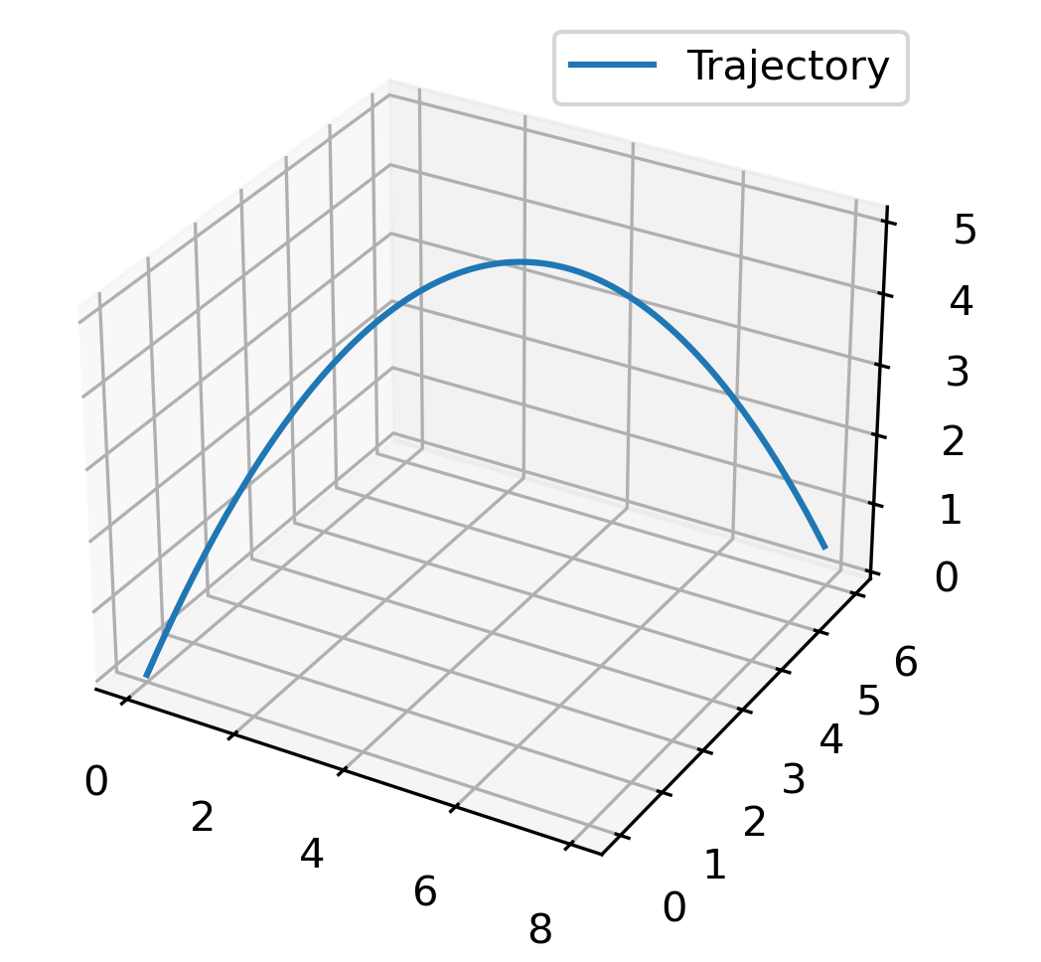


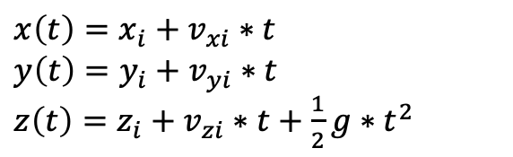

Projectile Motion
10
  Here we see an objects trajectory after being launched.
$$x\left(t\right)=x_{i}+v_{xi}∗t$$
$$y\left(t\right)=y_{i}+v_{yi}∗t$$
$z\left(t\right)=z_{i}+v_{zi}∗t+\frac{1}{2}g∗t^{2}$
Initial Position: $(x_{i}, y_{i}, z_{i})$
Initial Velocity: $(v_{xi}, v_{yi}, v_{zi})$
$g=9.81\frac{m}{s}$
Explore the Beauty of Physics Through Art!
Geometrical Art

Slide 11





Polar Coordinate System
11
  Rather than use (x(t), y(t)) to describe our system, we will use (r(t), θ(t)), Polar Coordinates!
    To convert between cartesian coordinates and polar coordinates we can use these:
$$y$$
$$x=r∗cos(θ)$$
$$y=r∗\sin\left(θ\right)$$
$$r=\sqrt{x^{2}+y^{2}}$$
$$θ=\tan^{−1}\left(\frac{y}{x}\right)$$
$$r$$
$$θ$$
$$x$$
Explore the Beauty of Physics Through Art!
Geometrical Art

Slide 12


Polar Coordinate System
12
  For a particle on a circular path, we have two different sets of coordinates:
Cartesian
Polar
time t | x(t) | y(t)
0 s | 1 | 0
1 s | 0 | 1
2 s | -1 | 0
3 s | 0 | -1
time t | r(t) | θ(t)
0 s | 1 | 0
1 s | 1 | π/2
2 s | 1 | π
3 s | 1 | 3π/2
$$r$$
$$θ$$
Explore the Beauty of Physics Through Art!
Geometrical Art

Slide 13
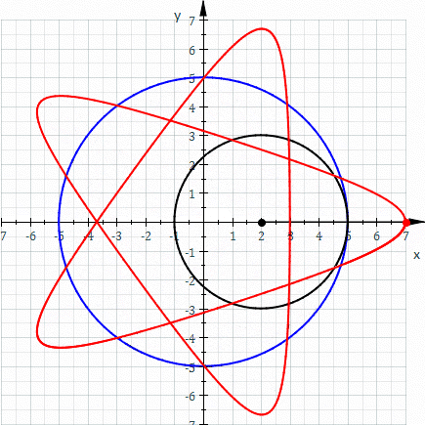
Hypotrochoids
13
Path traced out by
a point attached to a
smaller circle as it
rolls inside a bigger
circle.
Recall: Hypo- means beneath or below. In this case it refers to inside the circle.
2008-01-03 02:51 Sam Derbyshire Animation of an Hypotrochoid.
Explore the Beauty of Physics Through Art!
Geometrical Art

Slide 14
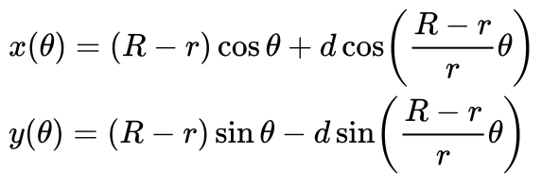
Hypotrochoids
14
r ~ inside circle radius
R ~ outer circle radius
d ~ distance to point from circle center
θ ~ angle between horizontal and center of rolling circle
θ
d
r
R
Explore the Beauty of Physics Through Art!
Geometrical Art

Slide 15
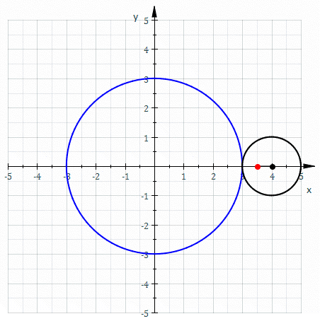
Epitrochoids
15
Path traced out by
a point attached to a
smaller circle as it
rolls outside a bigger
circle.
Recall: Epi- means over. In this case it means outside the circle.
2008-01-03 02:51 Sam Derbyshire Animation of an Epitrochoid.
Explore the Beauty of Physics Through Art!
Geometrical Art

Slide 16
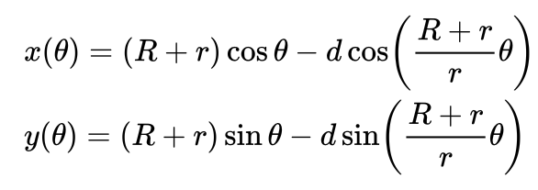
Epitrochoids
16
r ~ inside circle radius
R ~ outer circle radius
d ~ distance to point from circle center
θ ~ angle between horizontal and center of rolling circle
θ
d
r
R
Explore the Beauty of Physics Through Art!
Geometrical Art

Slide 17

Coding of Spirographs
17
We will be using Python coding to explore the spirographs.
https://colab.google is the site we will use to run the coding files
Explore the Beauty of Physics Through Art!
Geometrical Art

Slide 18
Coding of Spirographs
18
The files to explore for the spirographs:
  Hypotrochoid.ipynb
  Epitrochoid.ipynb
  If you are interested, you can also explore the parametric equations with these:
  ParametricEquationPlotter.ipynb
  3D-Projectile.ipynb
Explore the Beauty of Physics Through Art!
Geometrical Art

Slide 19

Coding of Spirographs
19
  Hypotrochoid.ipynb
Explore the Beauty of Physics Through Art!
Geometrical Art

Slide 20
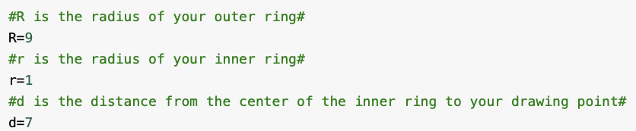
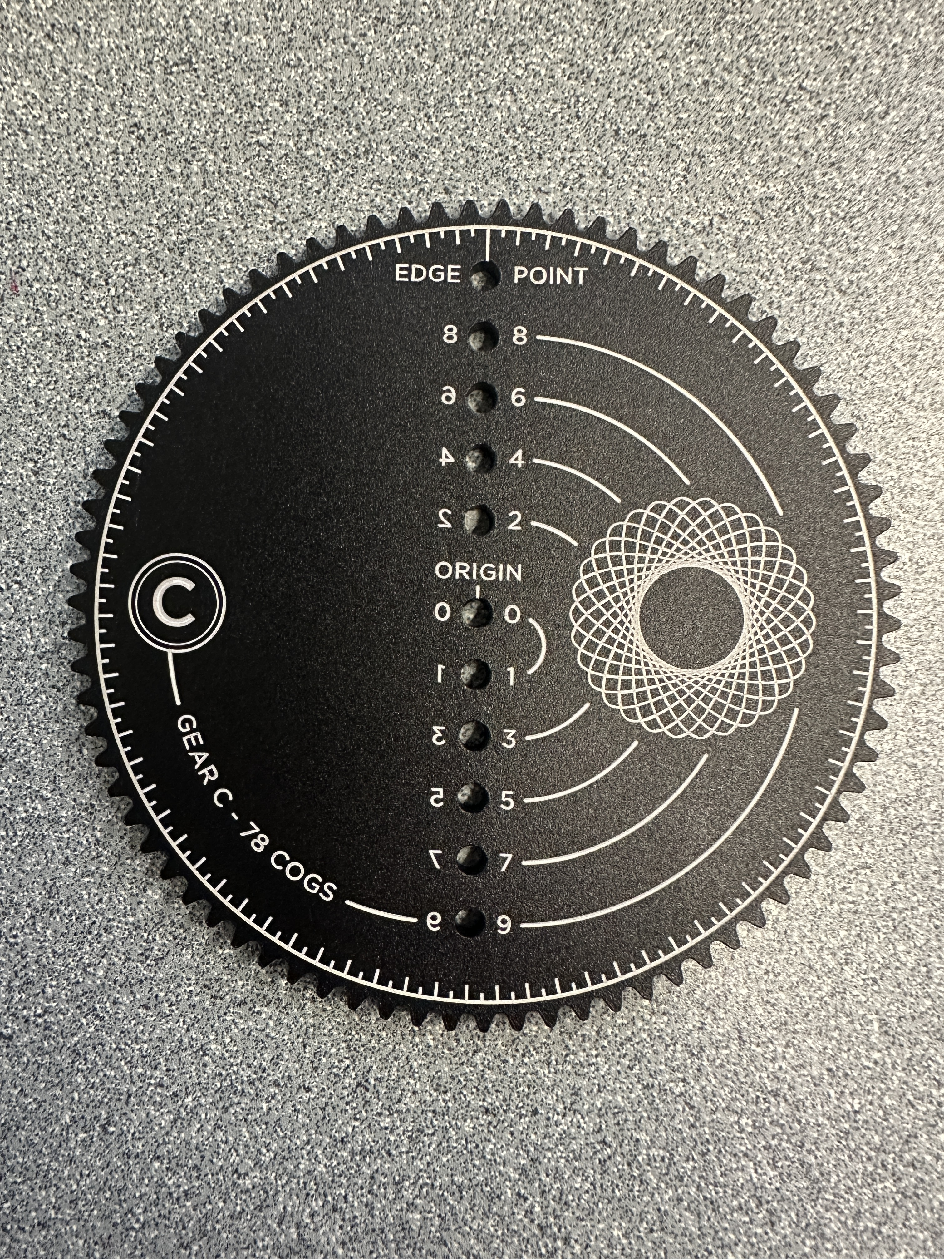
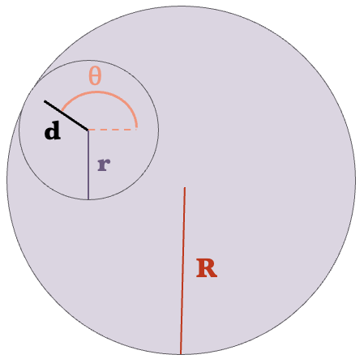
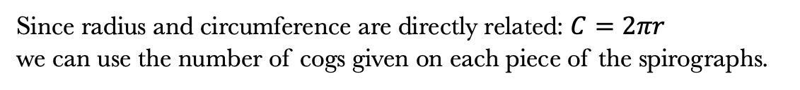
Coding of Spirographs
20
  Hypotrochoid.ipynb
Since radius and circumference are directly related: $C=2πr$
we can use the number of cogs given on each piece of the spirographs.
Explore the Beauty of Physics Through Art!
Geometrical Art

Slide 21
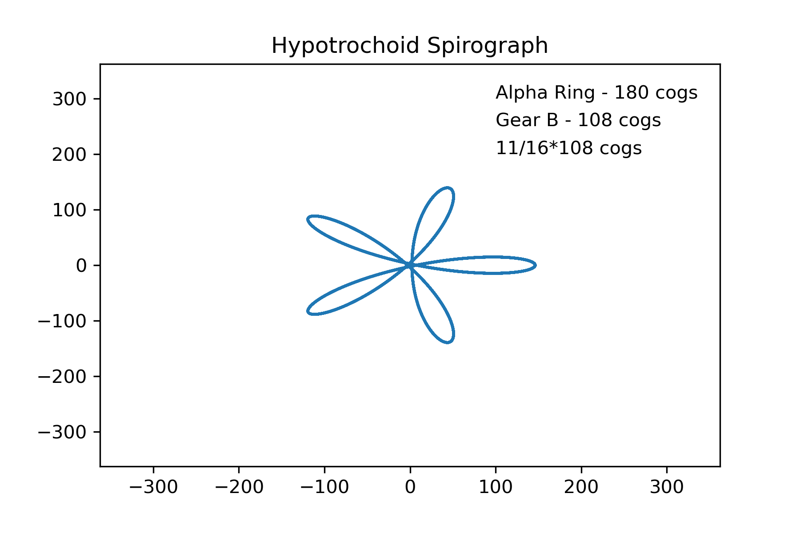
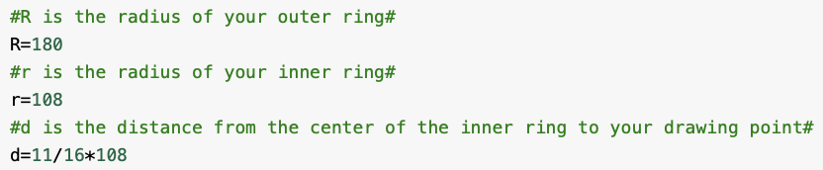
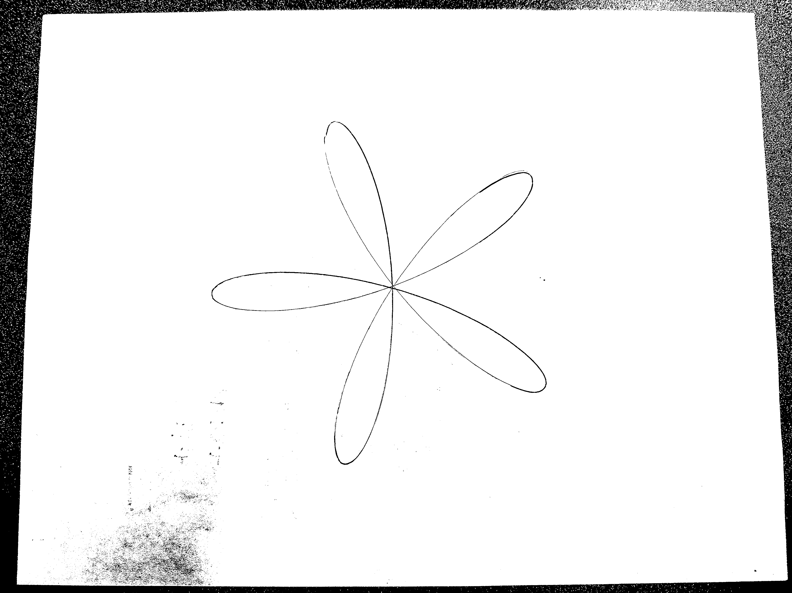
Coding of Spirographs
21
  Hypotrochoid.ipynb
Example 1:
Explore the Beauty of Physics Through Art!
Geometrical Art

Slide 22
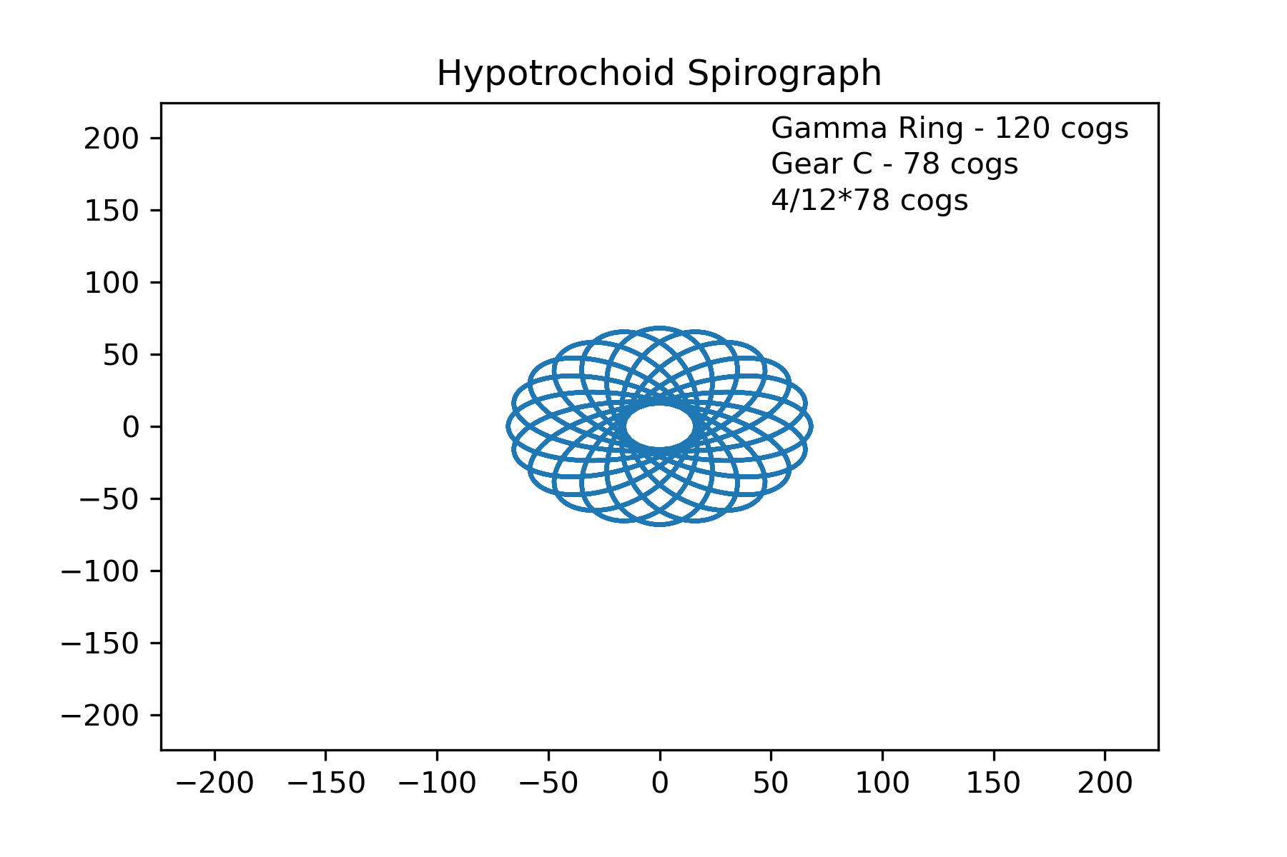
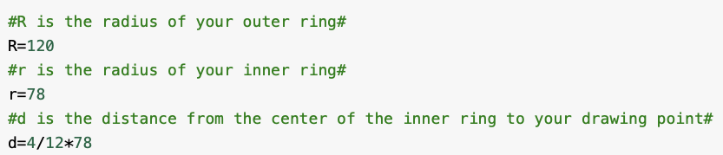
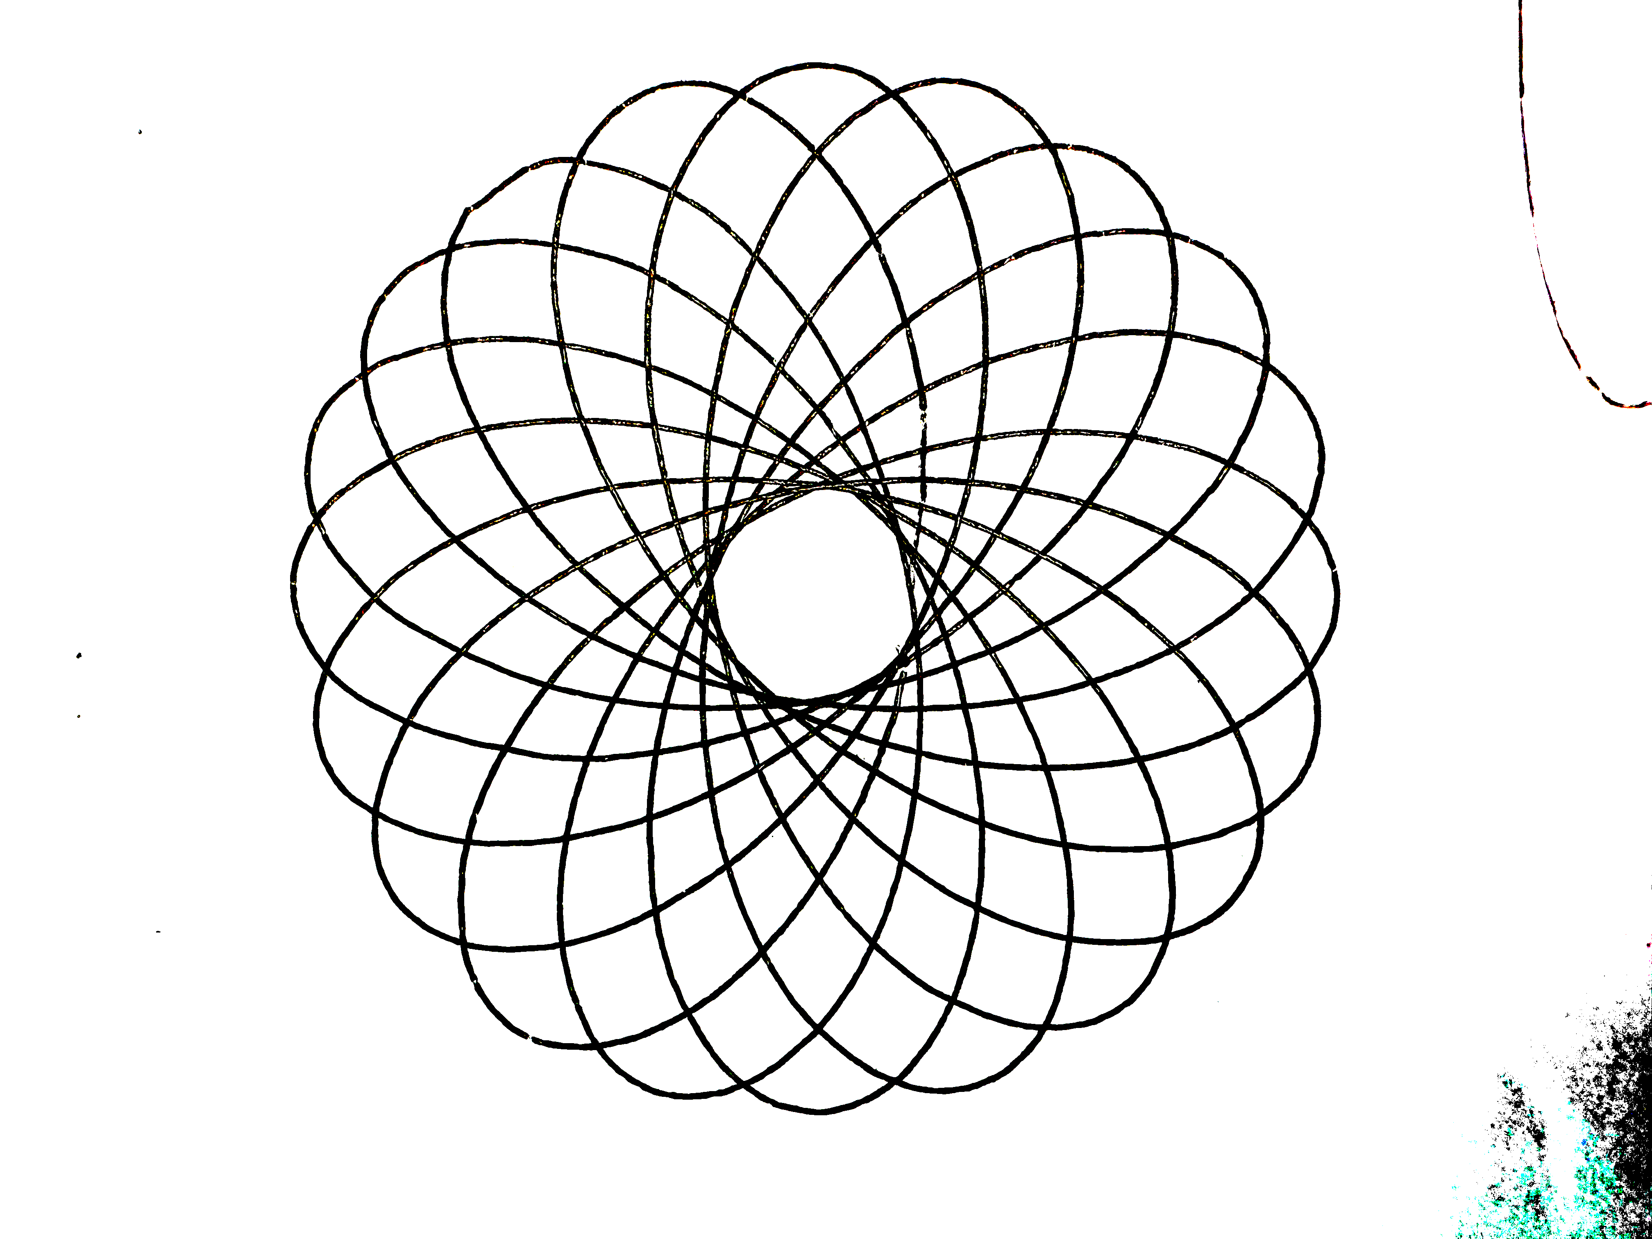
Coding of Spirographs
22
  Hypotrochoid.ipynb
Example 2:
Explore the Beauty of Physics Through Art!
Geometrical Art

Slide 23
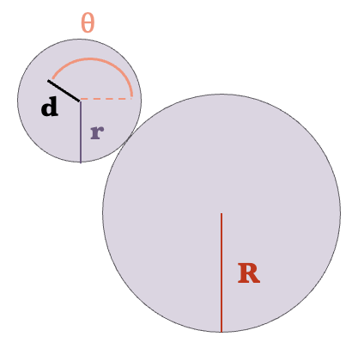
Hands on Application
23
Try and see if you can get your spirograph artwork to match the coding output.
Have fun and if you have any questions we are here to help!
Hypotrochoid
Epitrochoid
Explore the Beauty of Physics Through Art!
Geometrical Art

Slide 24
Summary
24
Learned mathematical principals to describe a spirographs motion.
Introduction to coding in Python in order to model the mathematics behind a spirograph.
Hands on application and created your own artwork!
Explore the Beauty of Physics Through Art!
Geometrical Art

Slide 25

Acknowledgments
25
This series is offered as part of the START SMART program:
  We gratefully accept funding from The National Science Foundation under grant no. 2203933
  We also are supported by the UNL CAS Research Impact and Engagement Grant: START SMART
Explore the Beauty of Physics Through Art!
Geometrical Art

